Slide 1
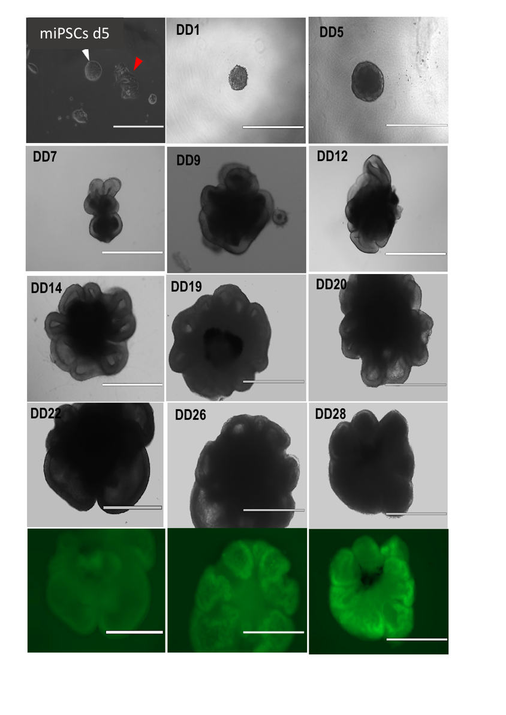
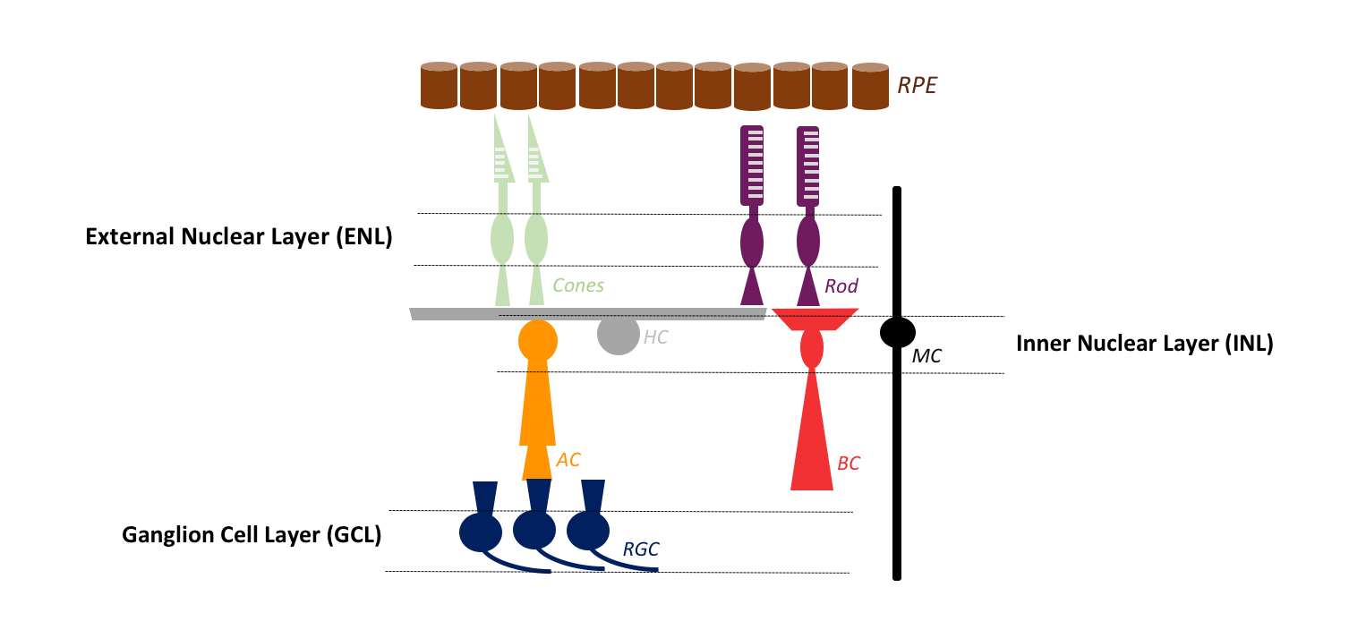
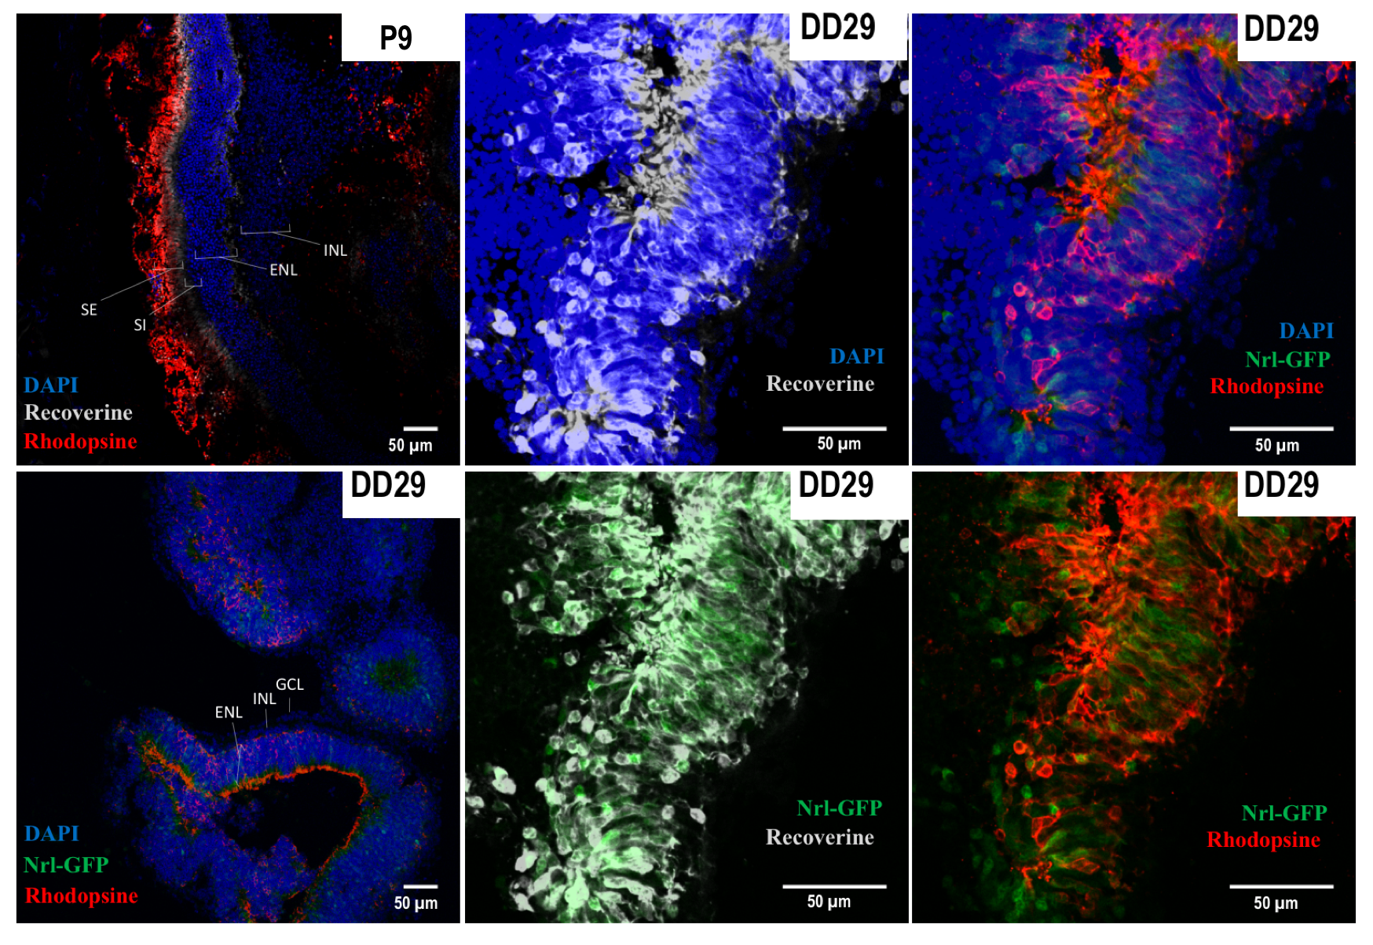
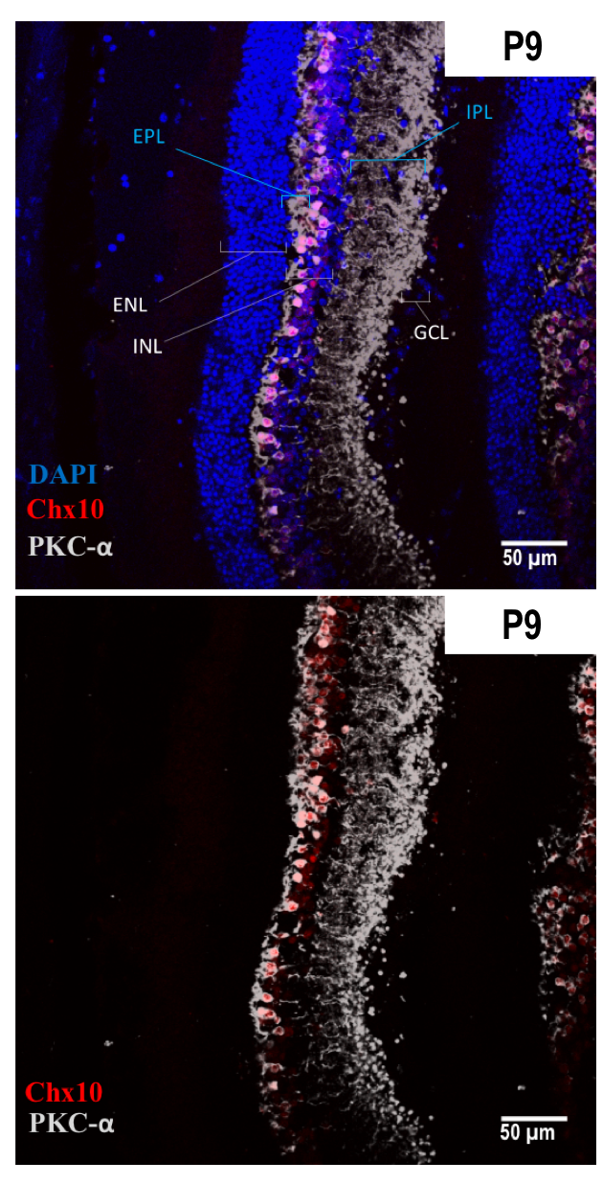
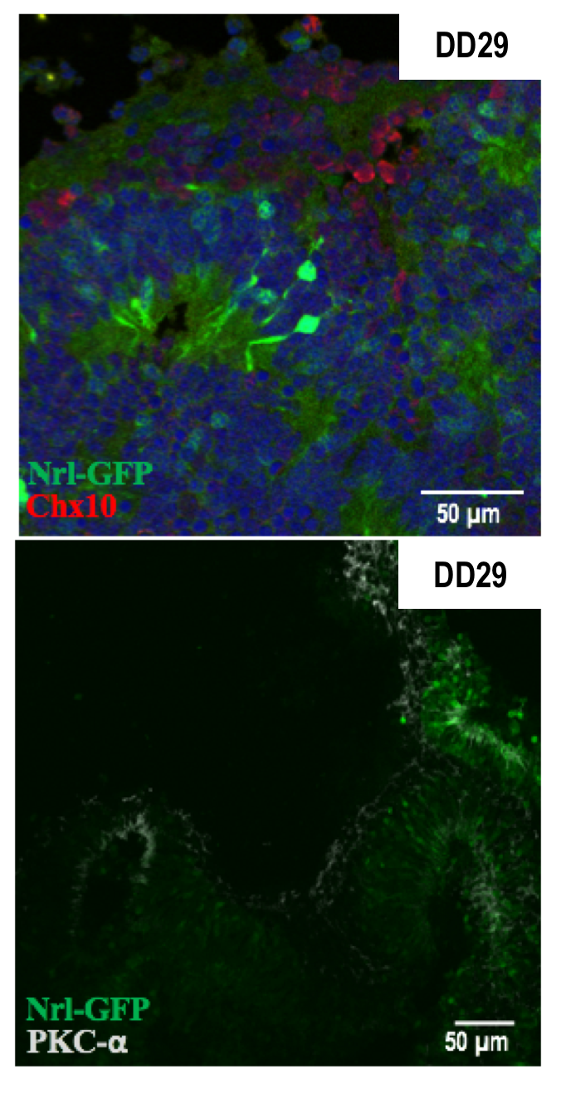
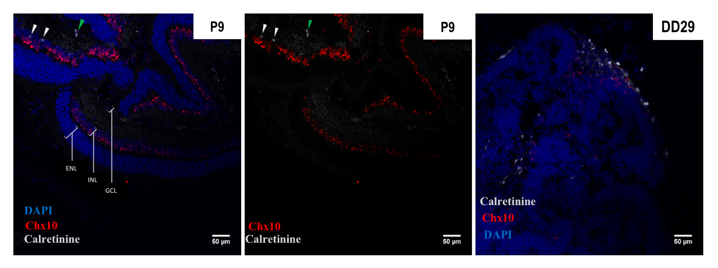
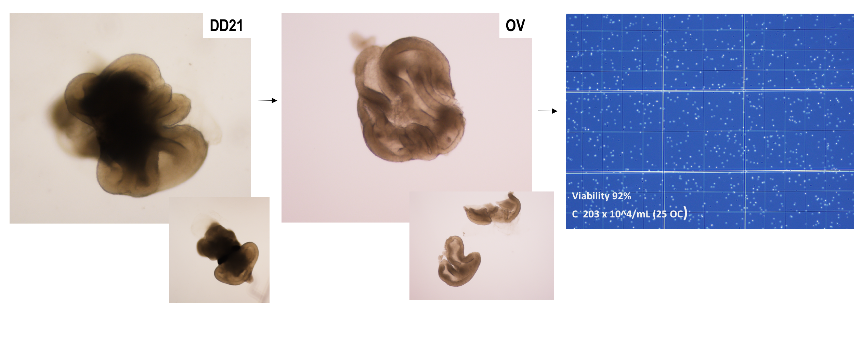
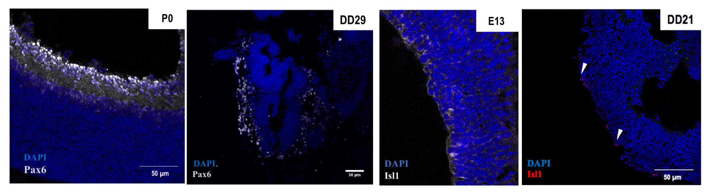
B
Photoreceptor Cells
A
Bipolar Cells
C
Amacrine Cells
D
Ganglion Cells

Slide 2
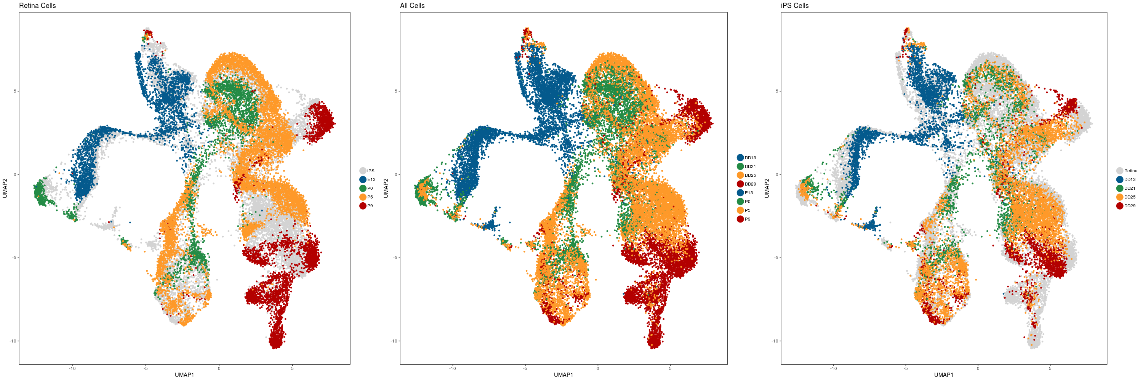
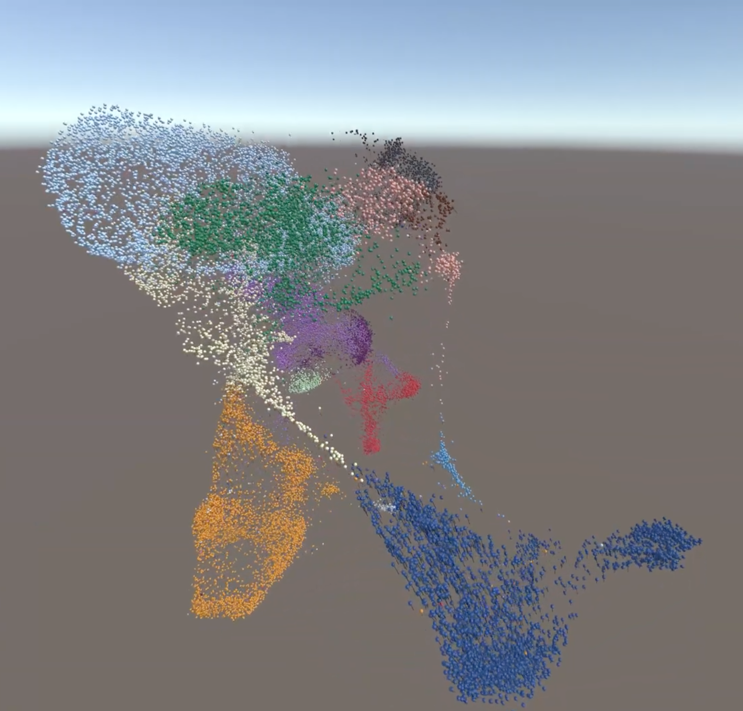
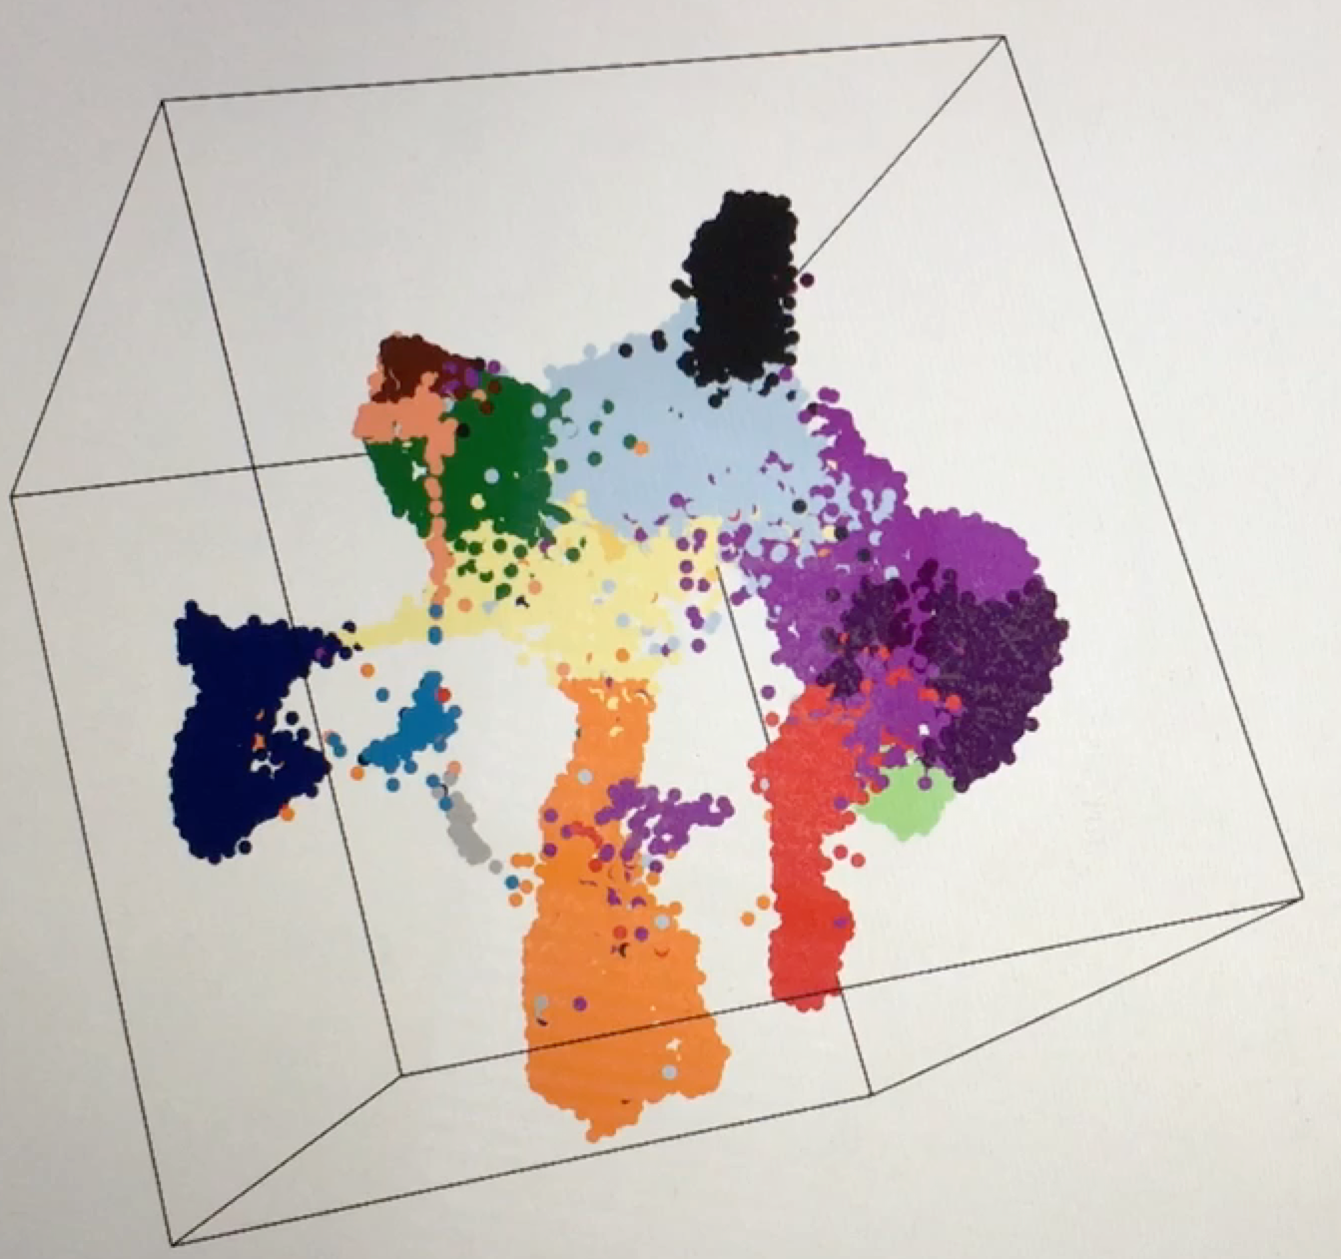
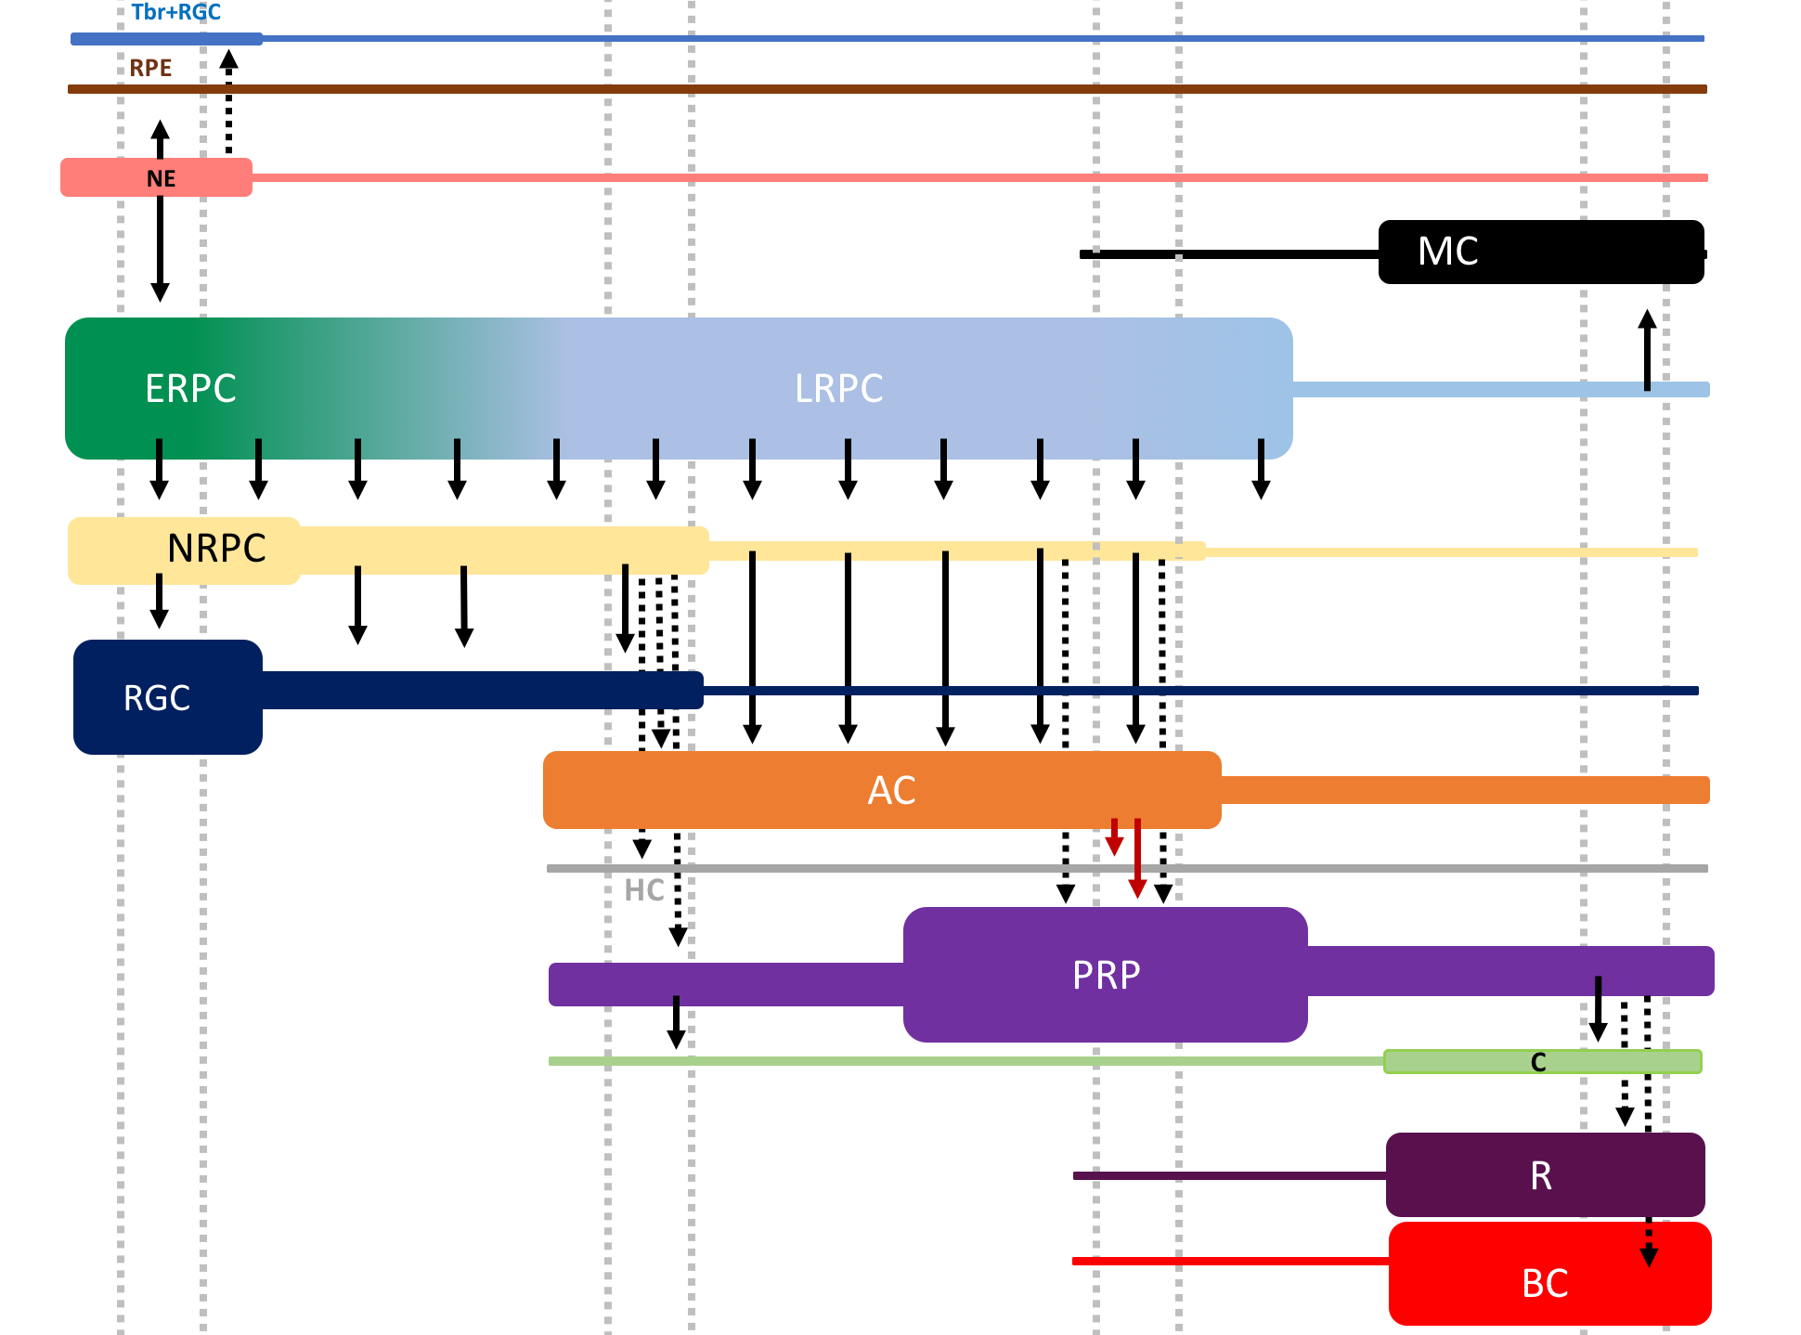
A
B
C
*
*
*
*
*
Stage I
Stage II
Stage III
Stage IV
D
E
F
Stage 1
Stage 2
Stage 3
Stage 4

Slide 3
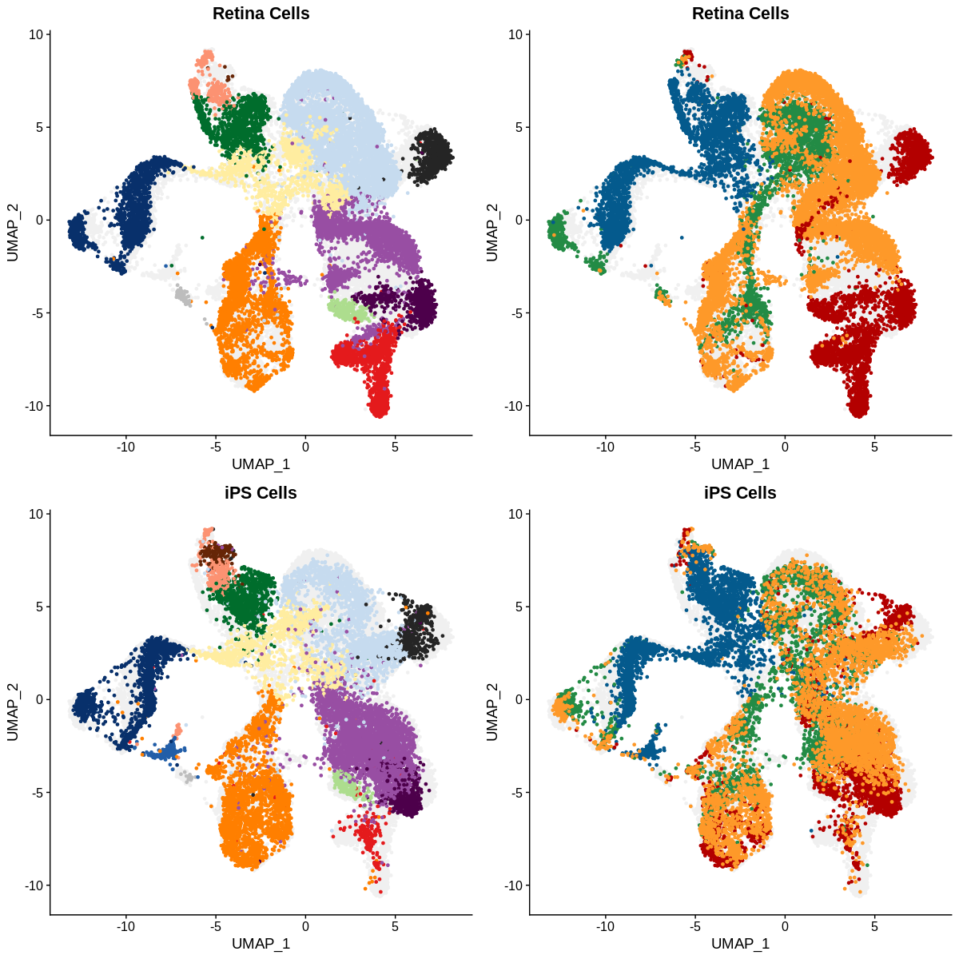
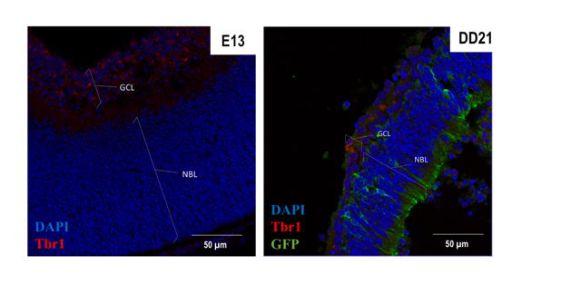
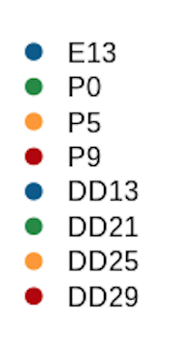
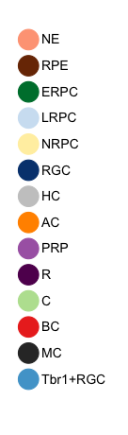
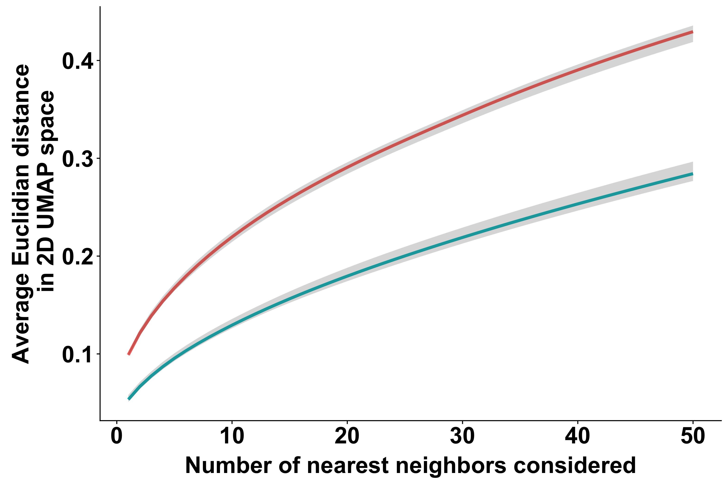
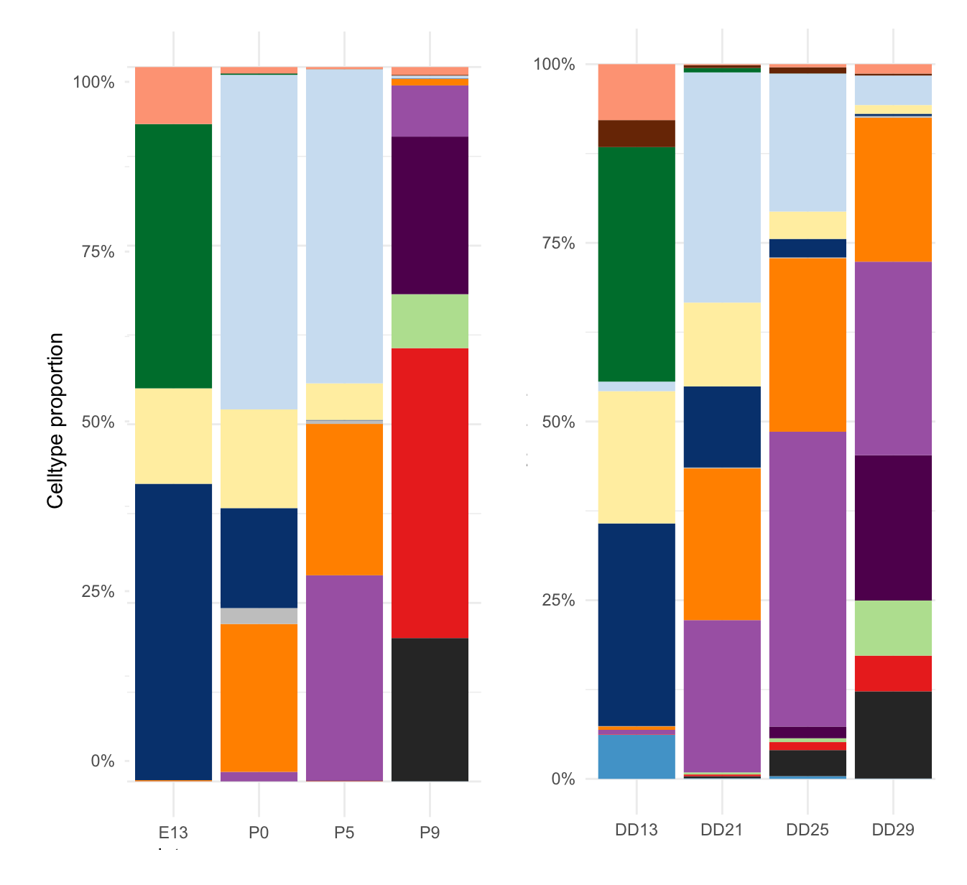
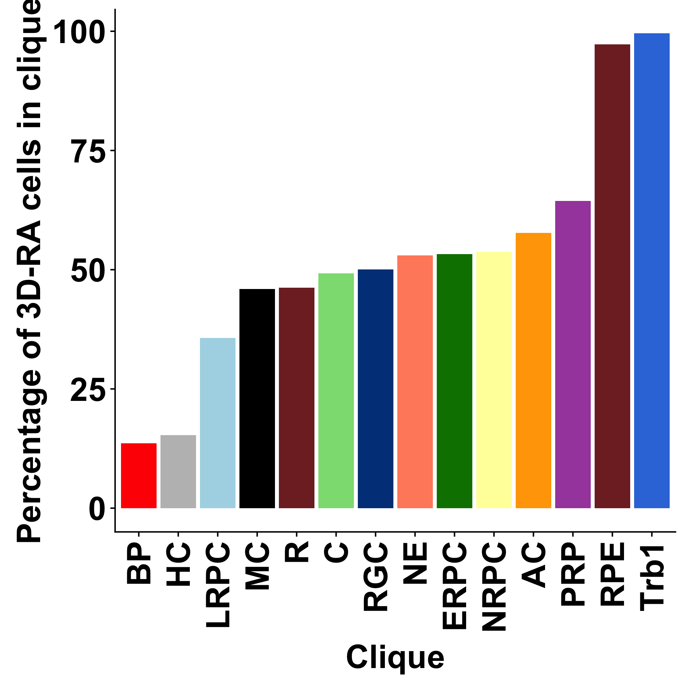
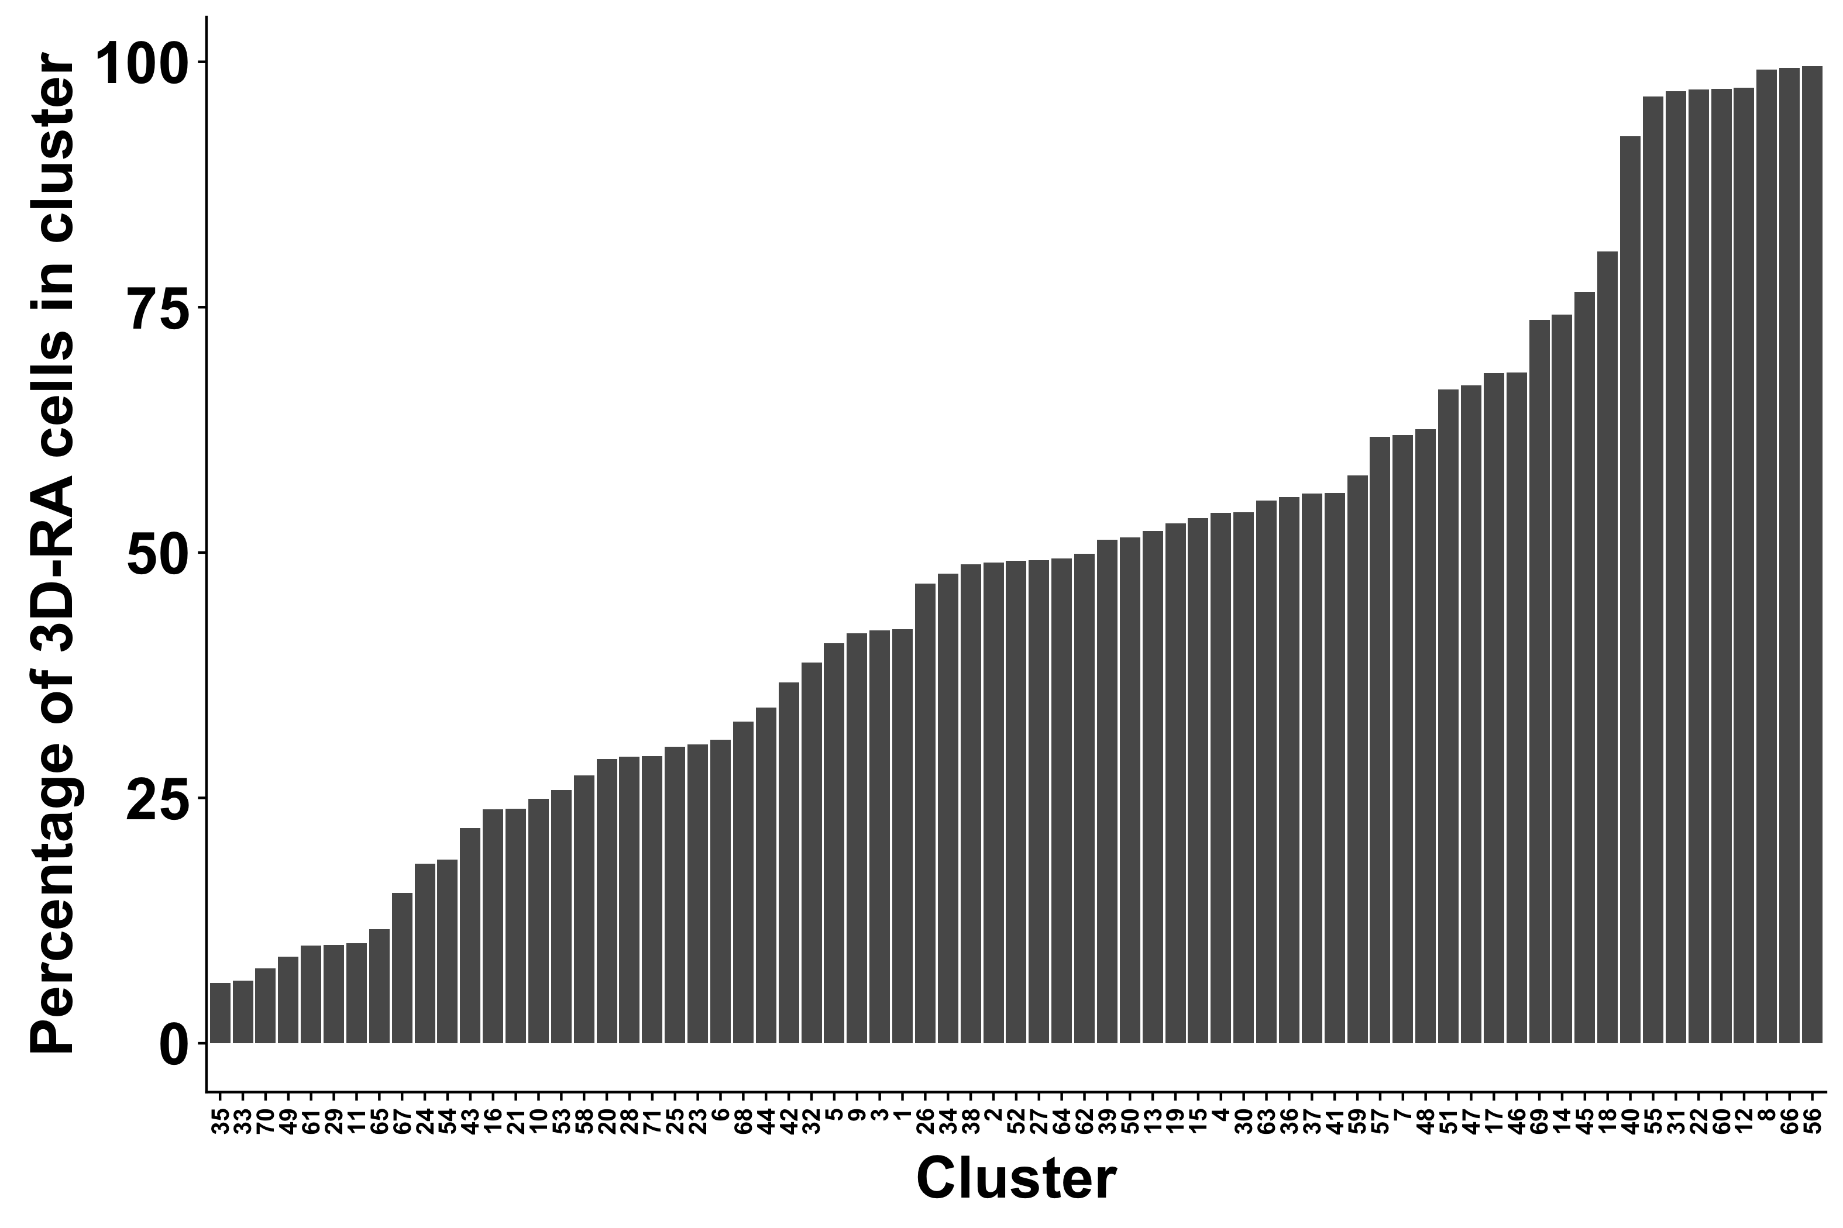
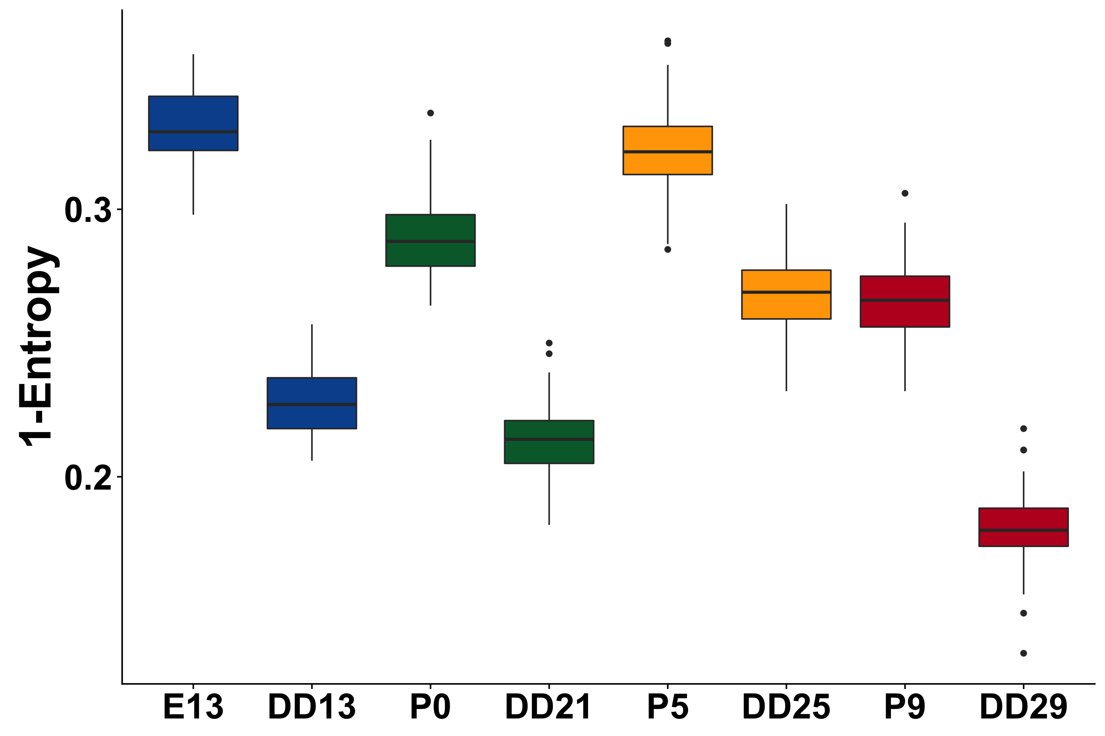
A
Nar
B
Nar
G
C
3D-RA
D
3D-RA
H
J
E
F
I
NaR
3D-RA

Slide 4
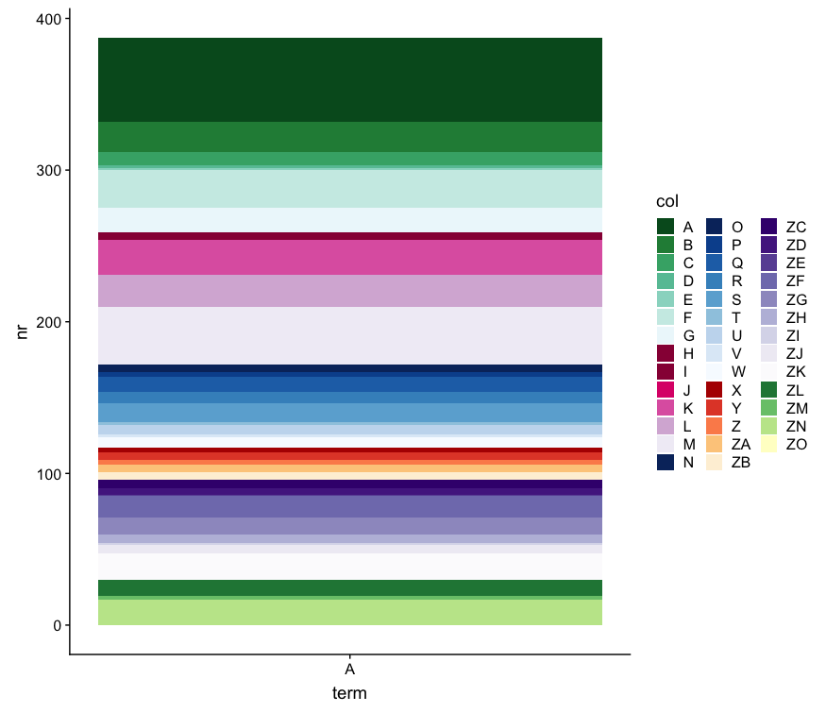
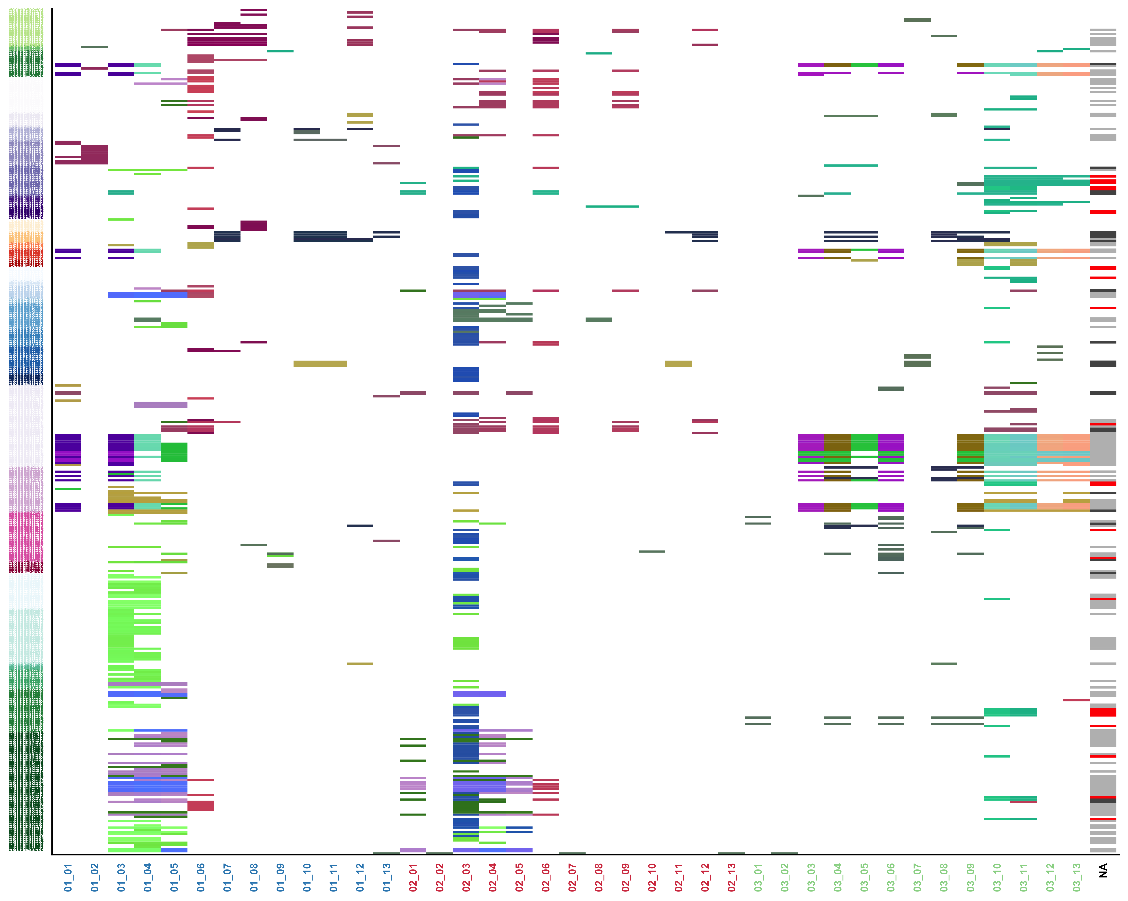
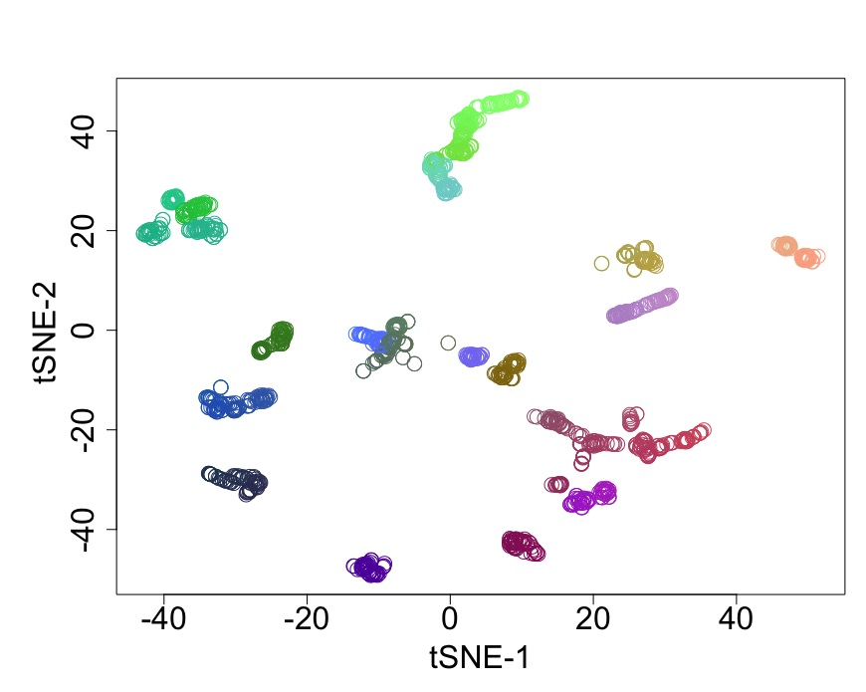
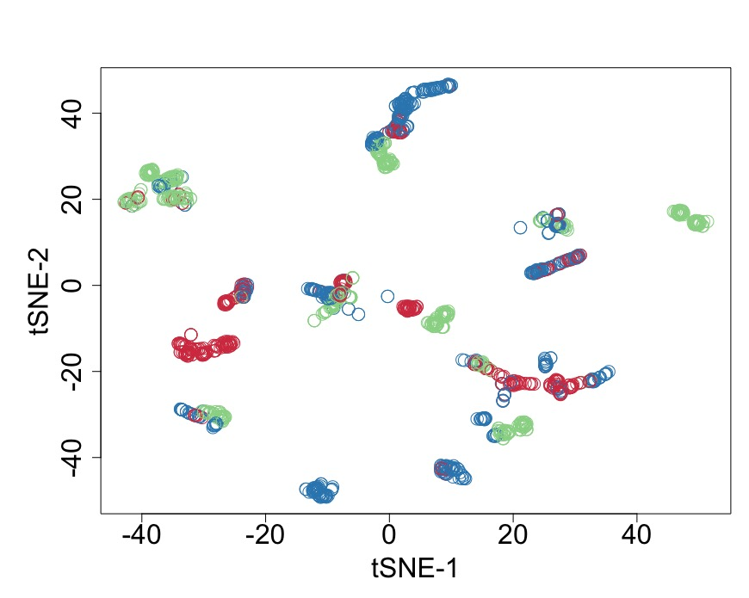
NE
RPE
ERPC
LRPC
NRPC
RGC
HC
AC
PRP
C
R
BC
MC
NE
RPE
ERPC
LRPC
NRPC
RGC
HC
AC
PRP
C
R
BC
MC
NE
RPE
ERPC
LRPC
NRPC
RGC
HC
AC
PRP
C
R
BC
MC
A
NE
B
ERPC
LRPC
Neurexins & neuroligins
MC
Synapses
Serotonin, GABA, dopamine
NaR
Glutamate
NRPC
DEVELOPMENT
NMDA
Synaptic transmission
Axon
guidance
NEUROG3
RGC
Ephrin signaling, semaphorin
SLIT & ROBO
NCAM, L1CAM
HC
Vesicle
mediated
transport
Rab regulation
Golgi to ER
ER to Golgi
AC
GLUT4
Gap junctions
ESCRT
PRP
CELL BIOLOGY
Transport of small molecules
Protein localization
R
Cilia & mito biosynthesis
C
Extra-cellular matrix
remodeling
Stress
Response
Metal ions, HSP90
BC
Senescence
Heat
Hypoxia
Cell cell communication
Autophagy
Apoptosis
NE
Integration
METABOLISM
TCA
ERPC
Lipids (cholesterol)
Amino-acids (selenocysteine)
LRPC
Carbohydrates
Wnt
MC
TGFbeta
RHO GTPases
NRPC
3D-RA
Esr
RGC
SIGNAL TRANSDUCTION
Notch
HC
HedgeHog
AC
GPCR
phototransduction
MAPK
PRP
2nd messengers, Death rec
Unfolded protein response – UPR
R
Protein
metabolism
Post-translational modifications
C
Protein folding
SRP-dependent targeting
BC
Translation termination & elongation
Translation initiation
GENE EXPRESSION
RNA
metabolism
tRNA & rRNA processing
CLIQUE > OTHERS
NaR > 3D-RA
AU rich elements
mRNA processing
90
NMD
C
111
57
Pol II
transcription
TP53
RUNX1-3
MECP2
25
E2F6, AP-2, FOXO
Nr perturbed
Reactome
pathways
Epigenetic regulation
42
25
DNA
replication
post-replicative switching of ORI
Leading & lagging strand synthesis
Pre-initiation
Nucleotide excision repair
Double-stranded break repair
42
DNA repair
DNA damage bypass
D
Base excision repair
3D-RA > NaR
Chromosome maintenance
Nucleosome assemble
Telomere maintenance
CELL CYCLE
Mitotic spindle
R=tSNE1
G=tSNE2
B=tSNE3
CLIQUE > OTHERS
Checkpoints
G2/M
NaR > 3D-RA
G1/S damage
3D-RA> NaR
APC/C-mediated degradation
of cell cycle protein
NE
RPE
ERPC
LRPC
NRPC
RGC
HC
AC
PRP
C
R
BC
MC
NE
RPE
ERPC
LRPC
NRPC
RGC
HC
AC
PRP
C
R
BC
MC
NE
RPE
ERPC
LRPC
NRPC
RGC
HC
AC
PRP
C
R
BC
MC
Mitosis
M phase
G2-G2/M phases
S phase
G1-G1/S phases
NaR > 3D-RA
OVERLAP
CLIQUE > OTHERS
3D-RA > NaR

Slide 5
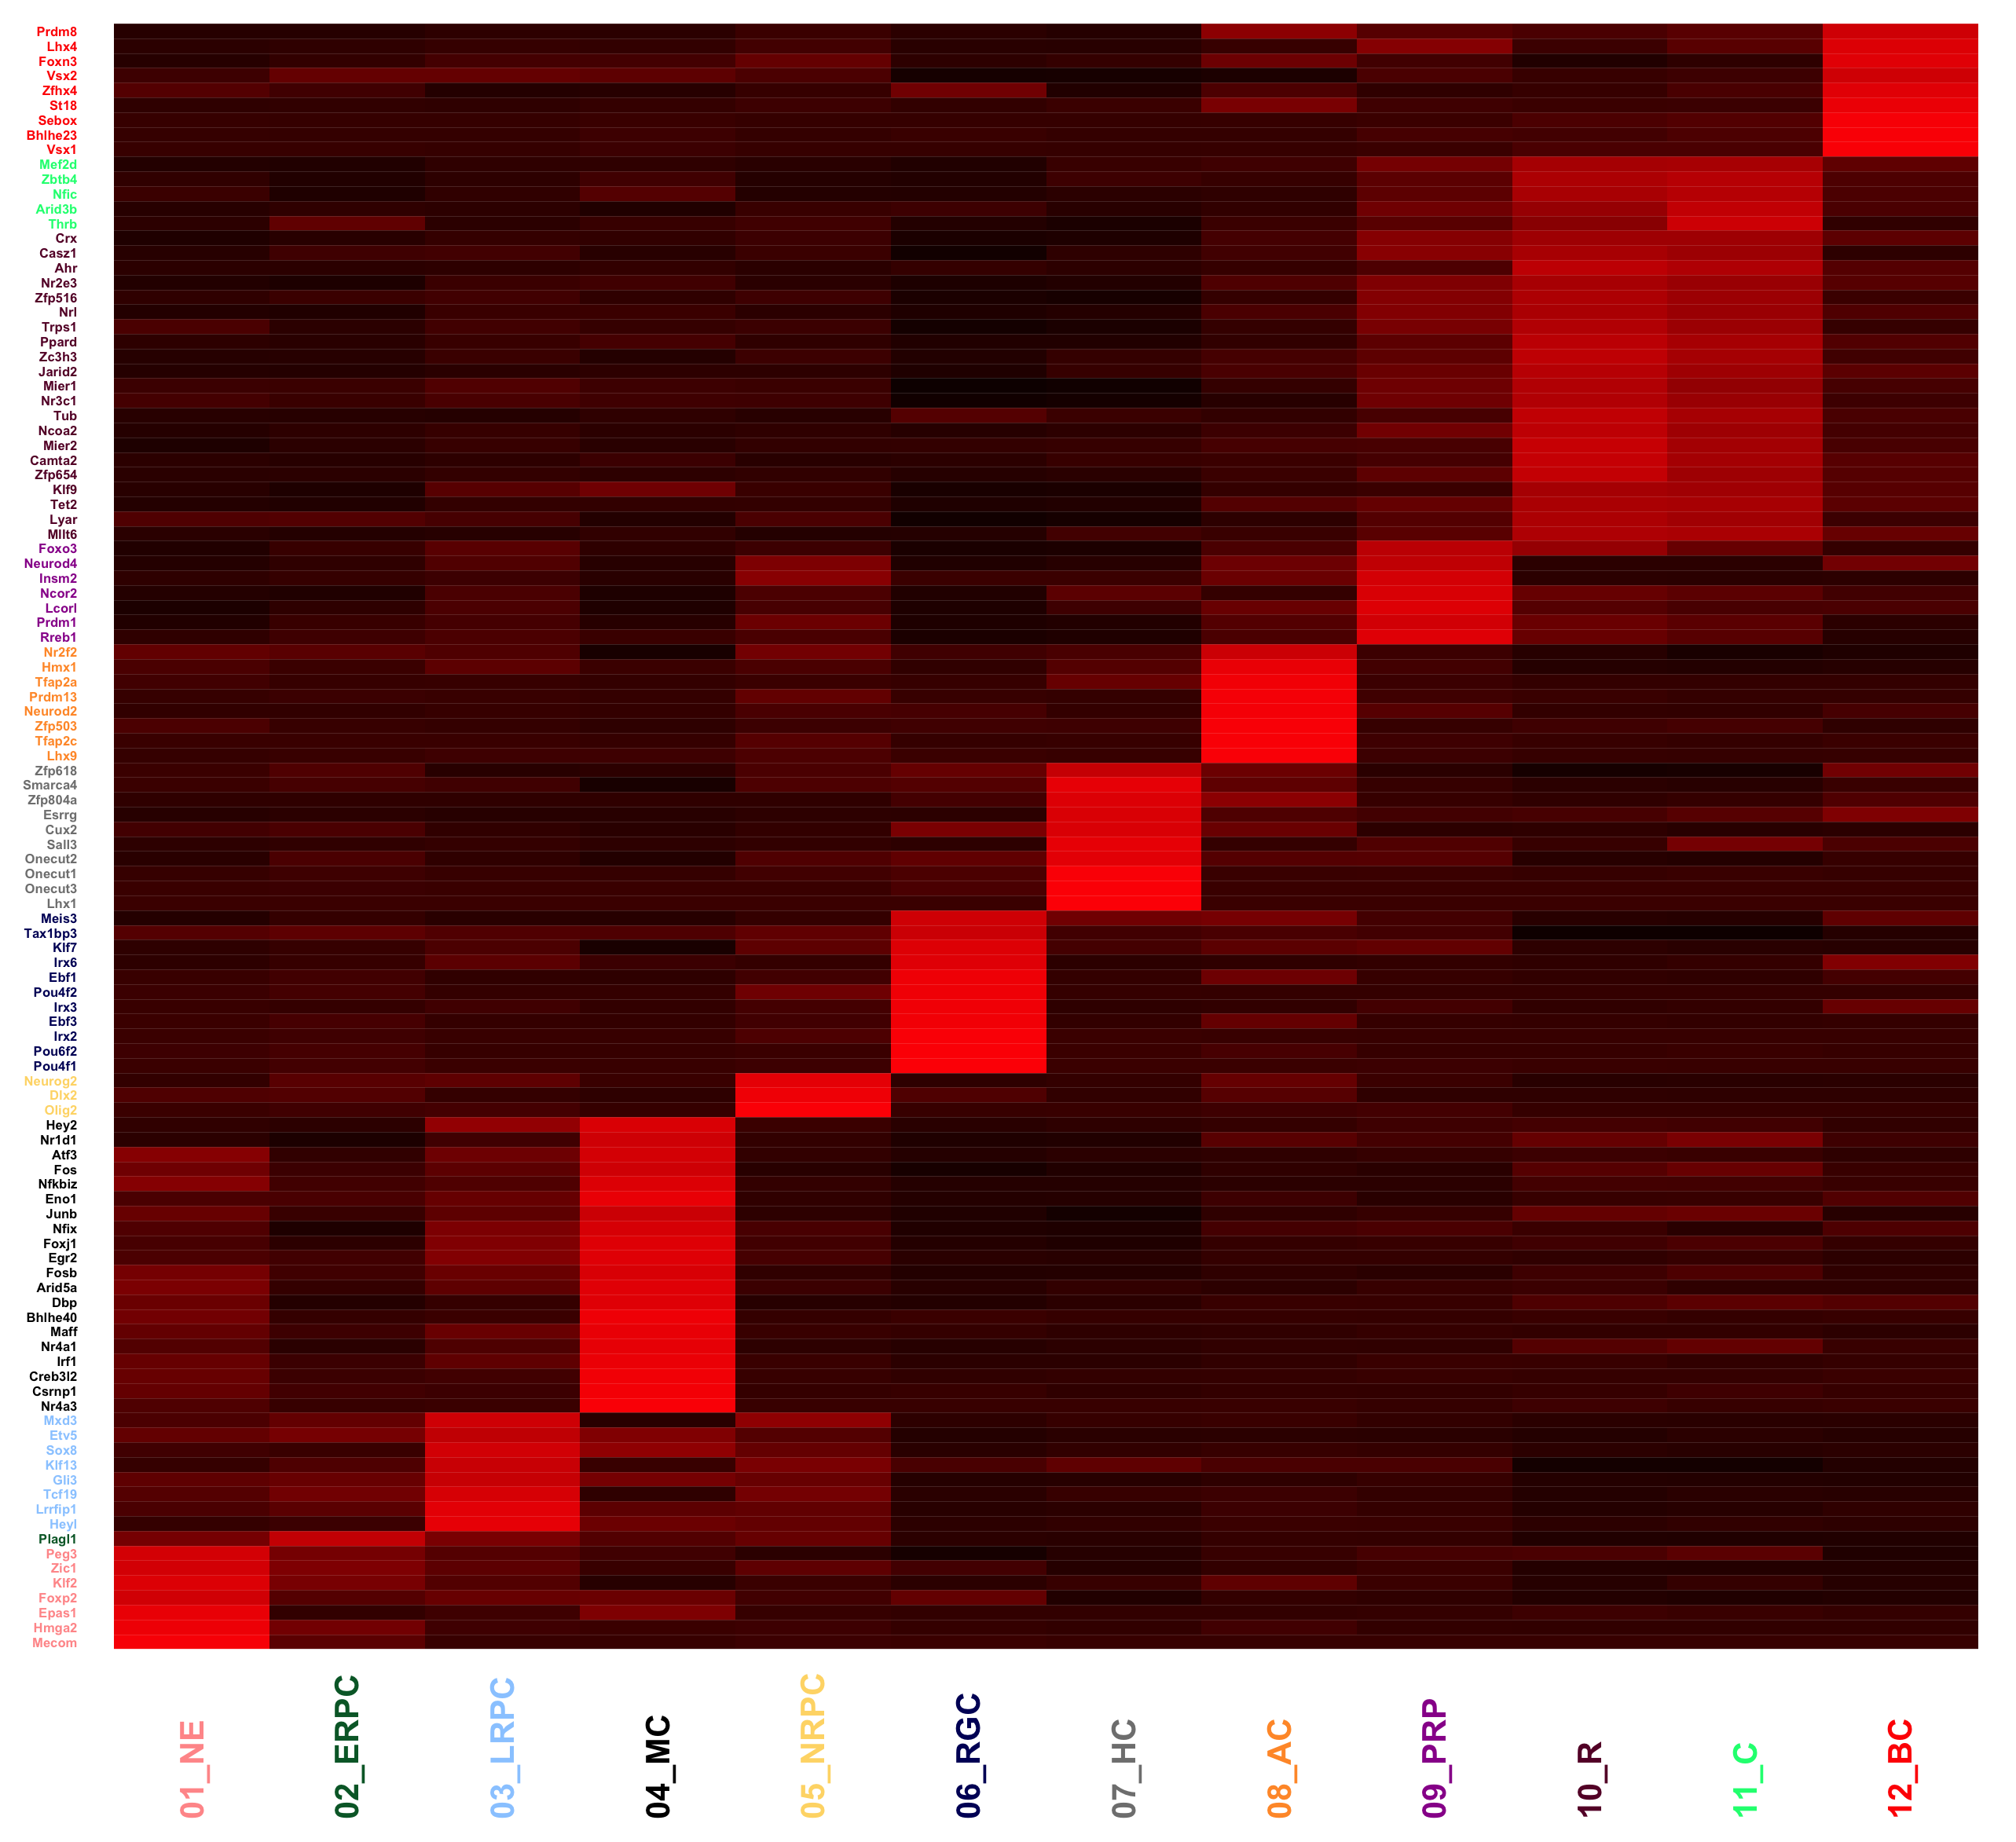
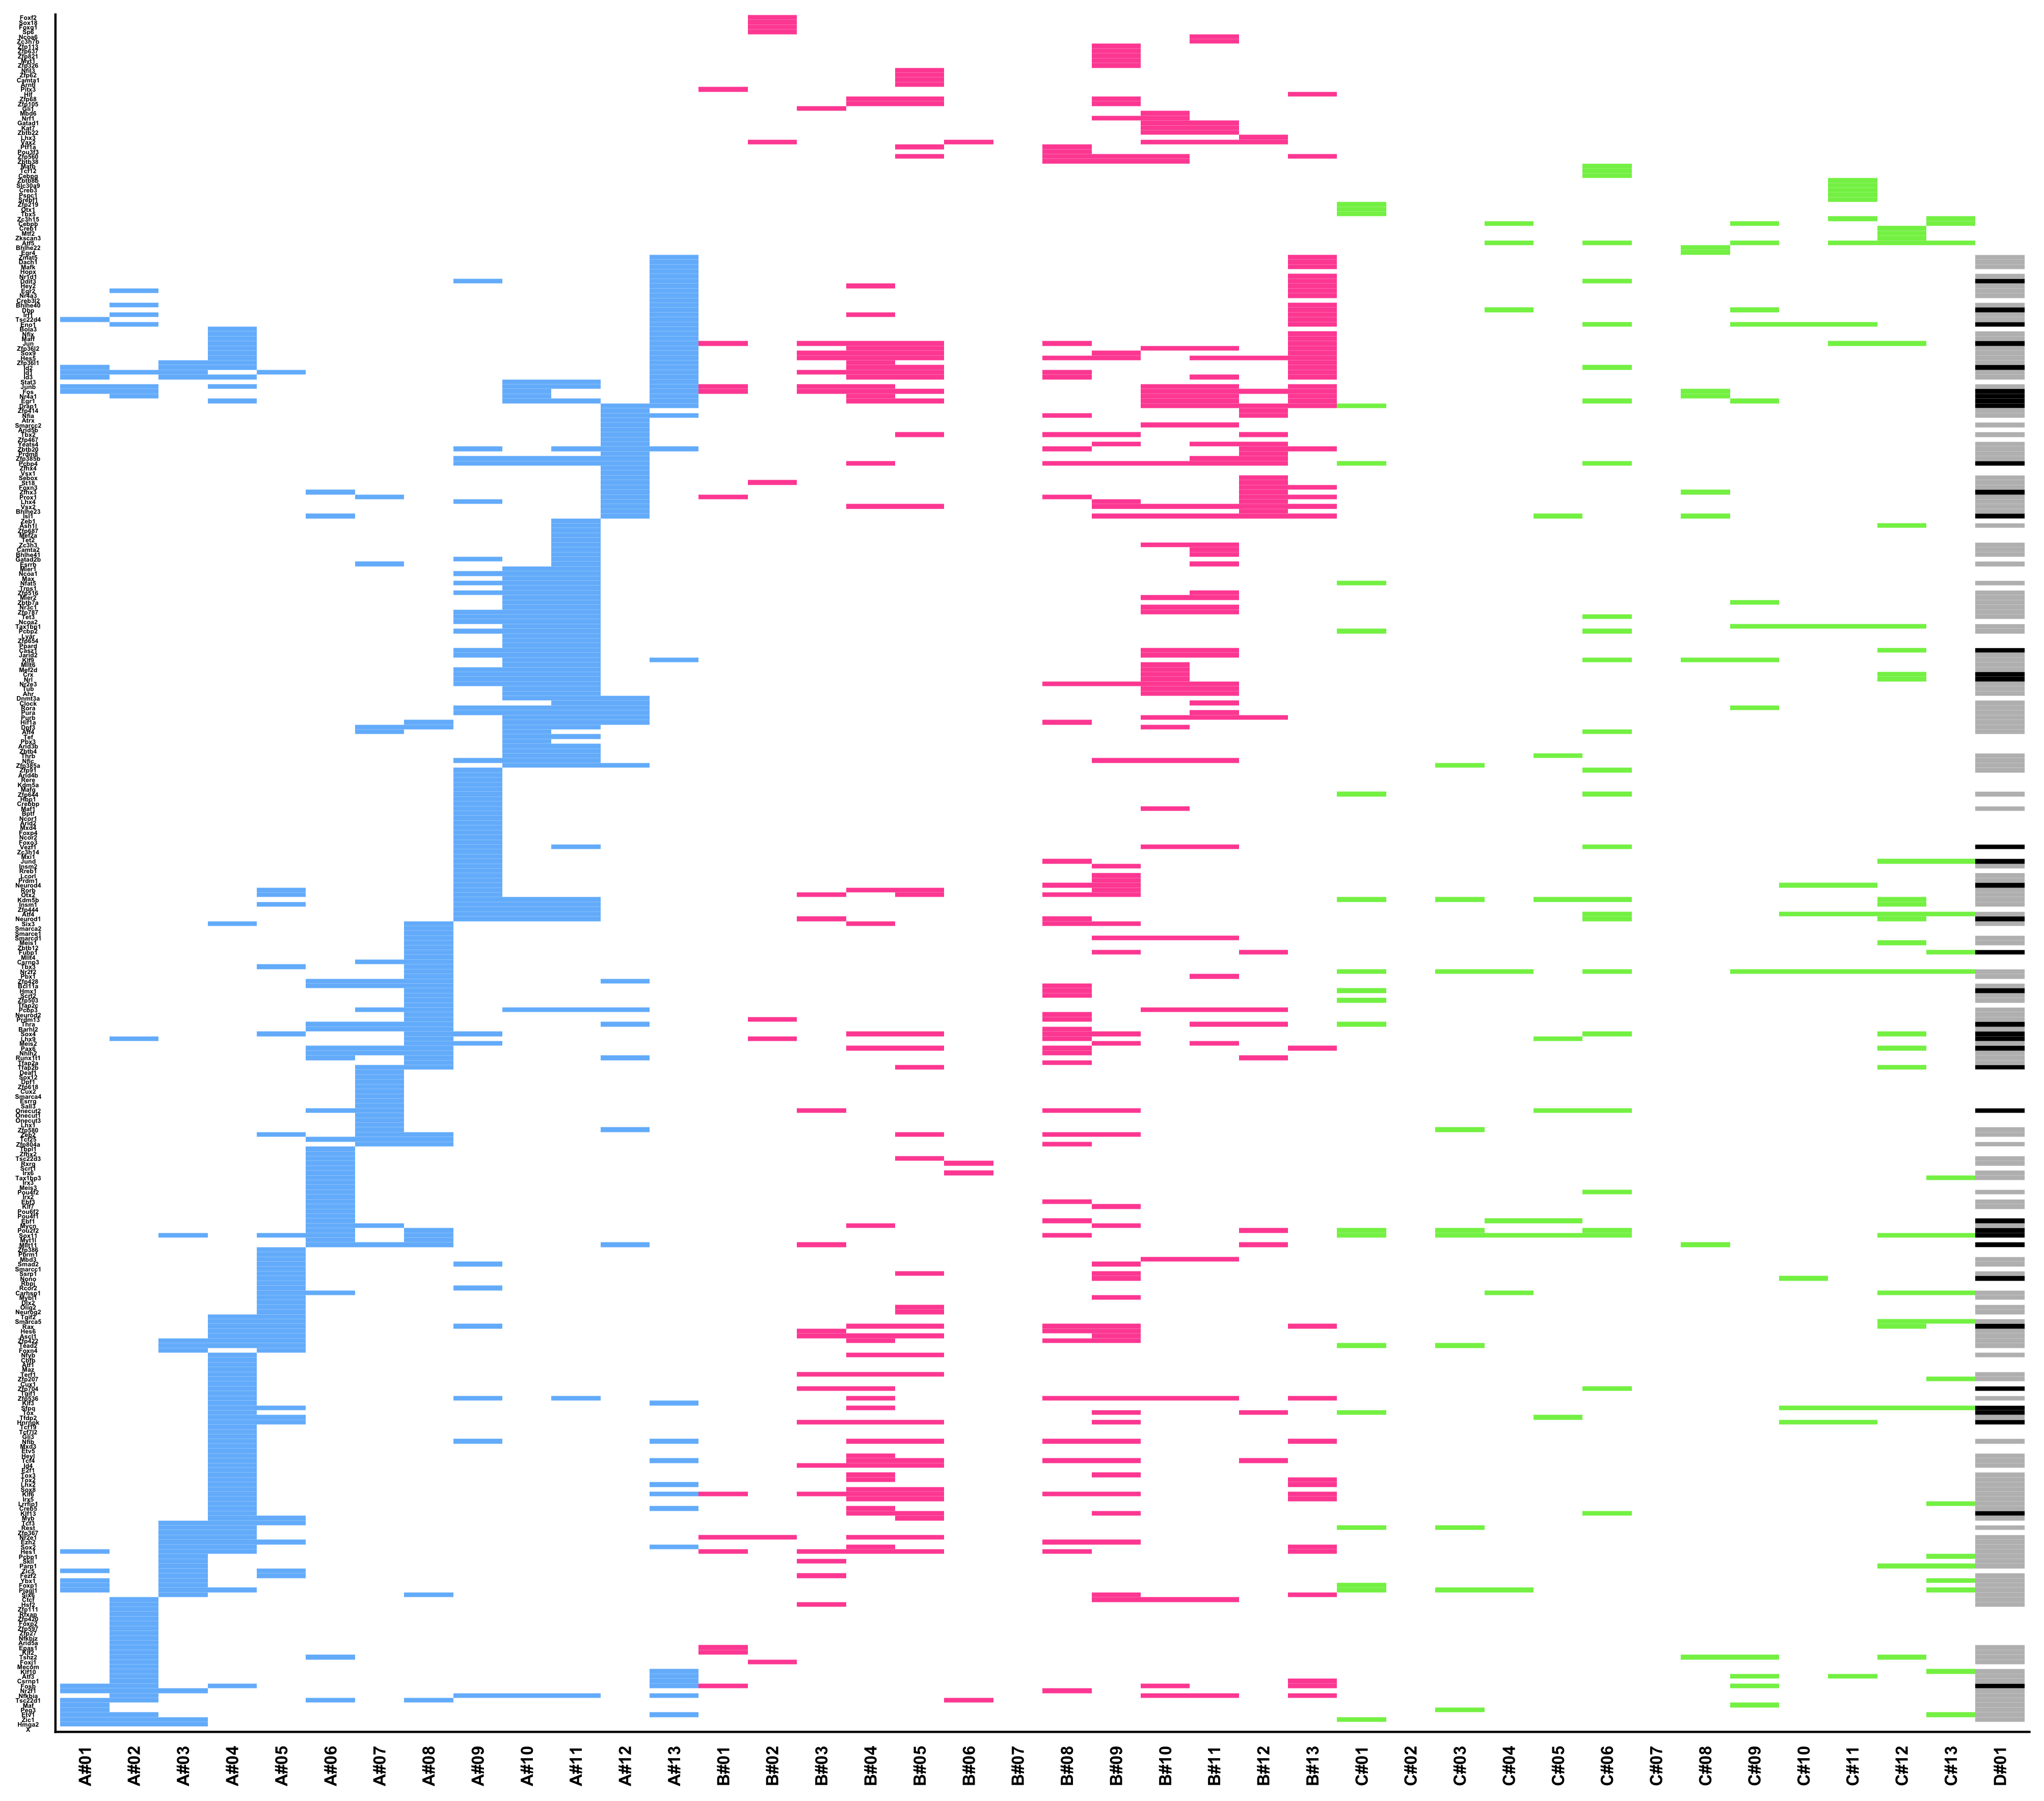
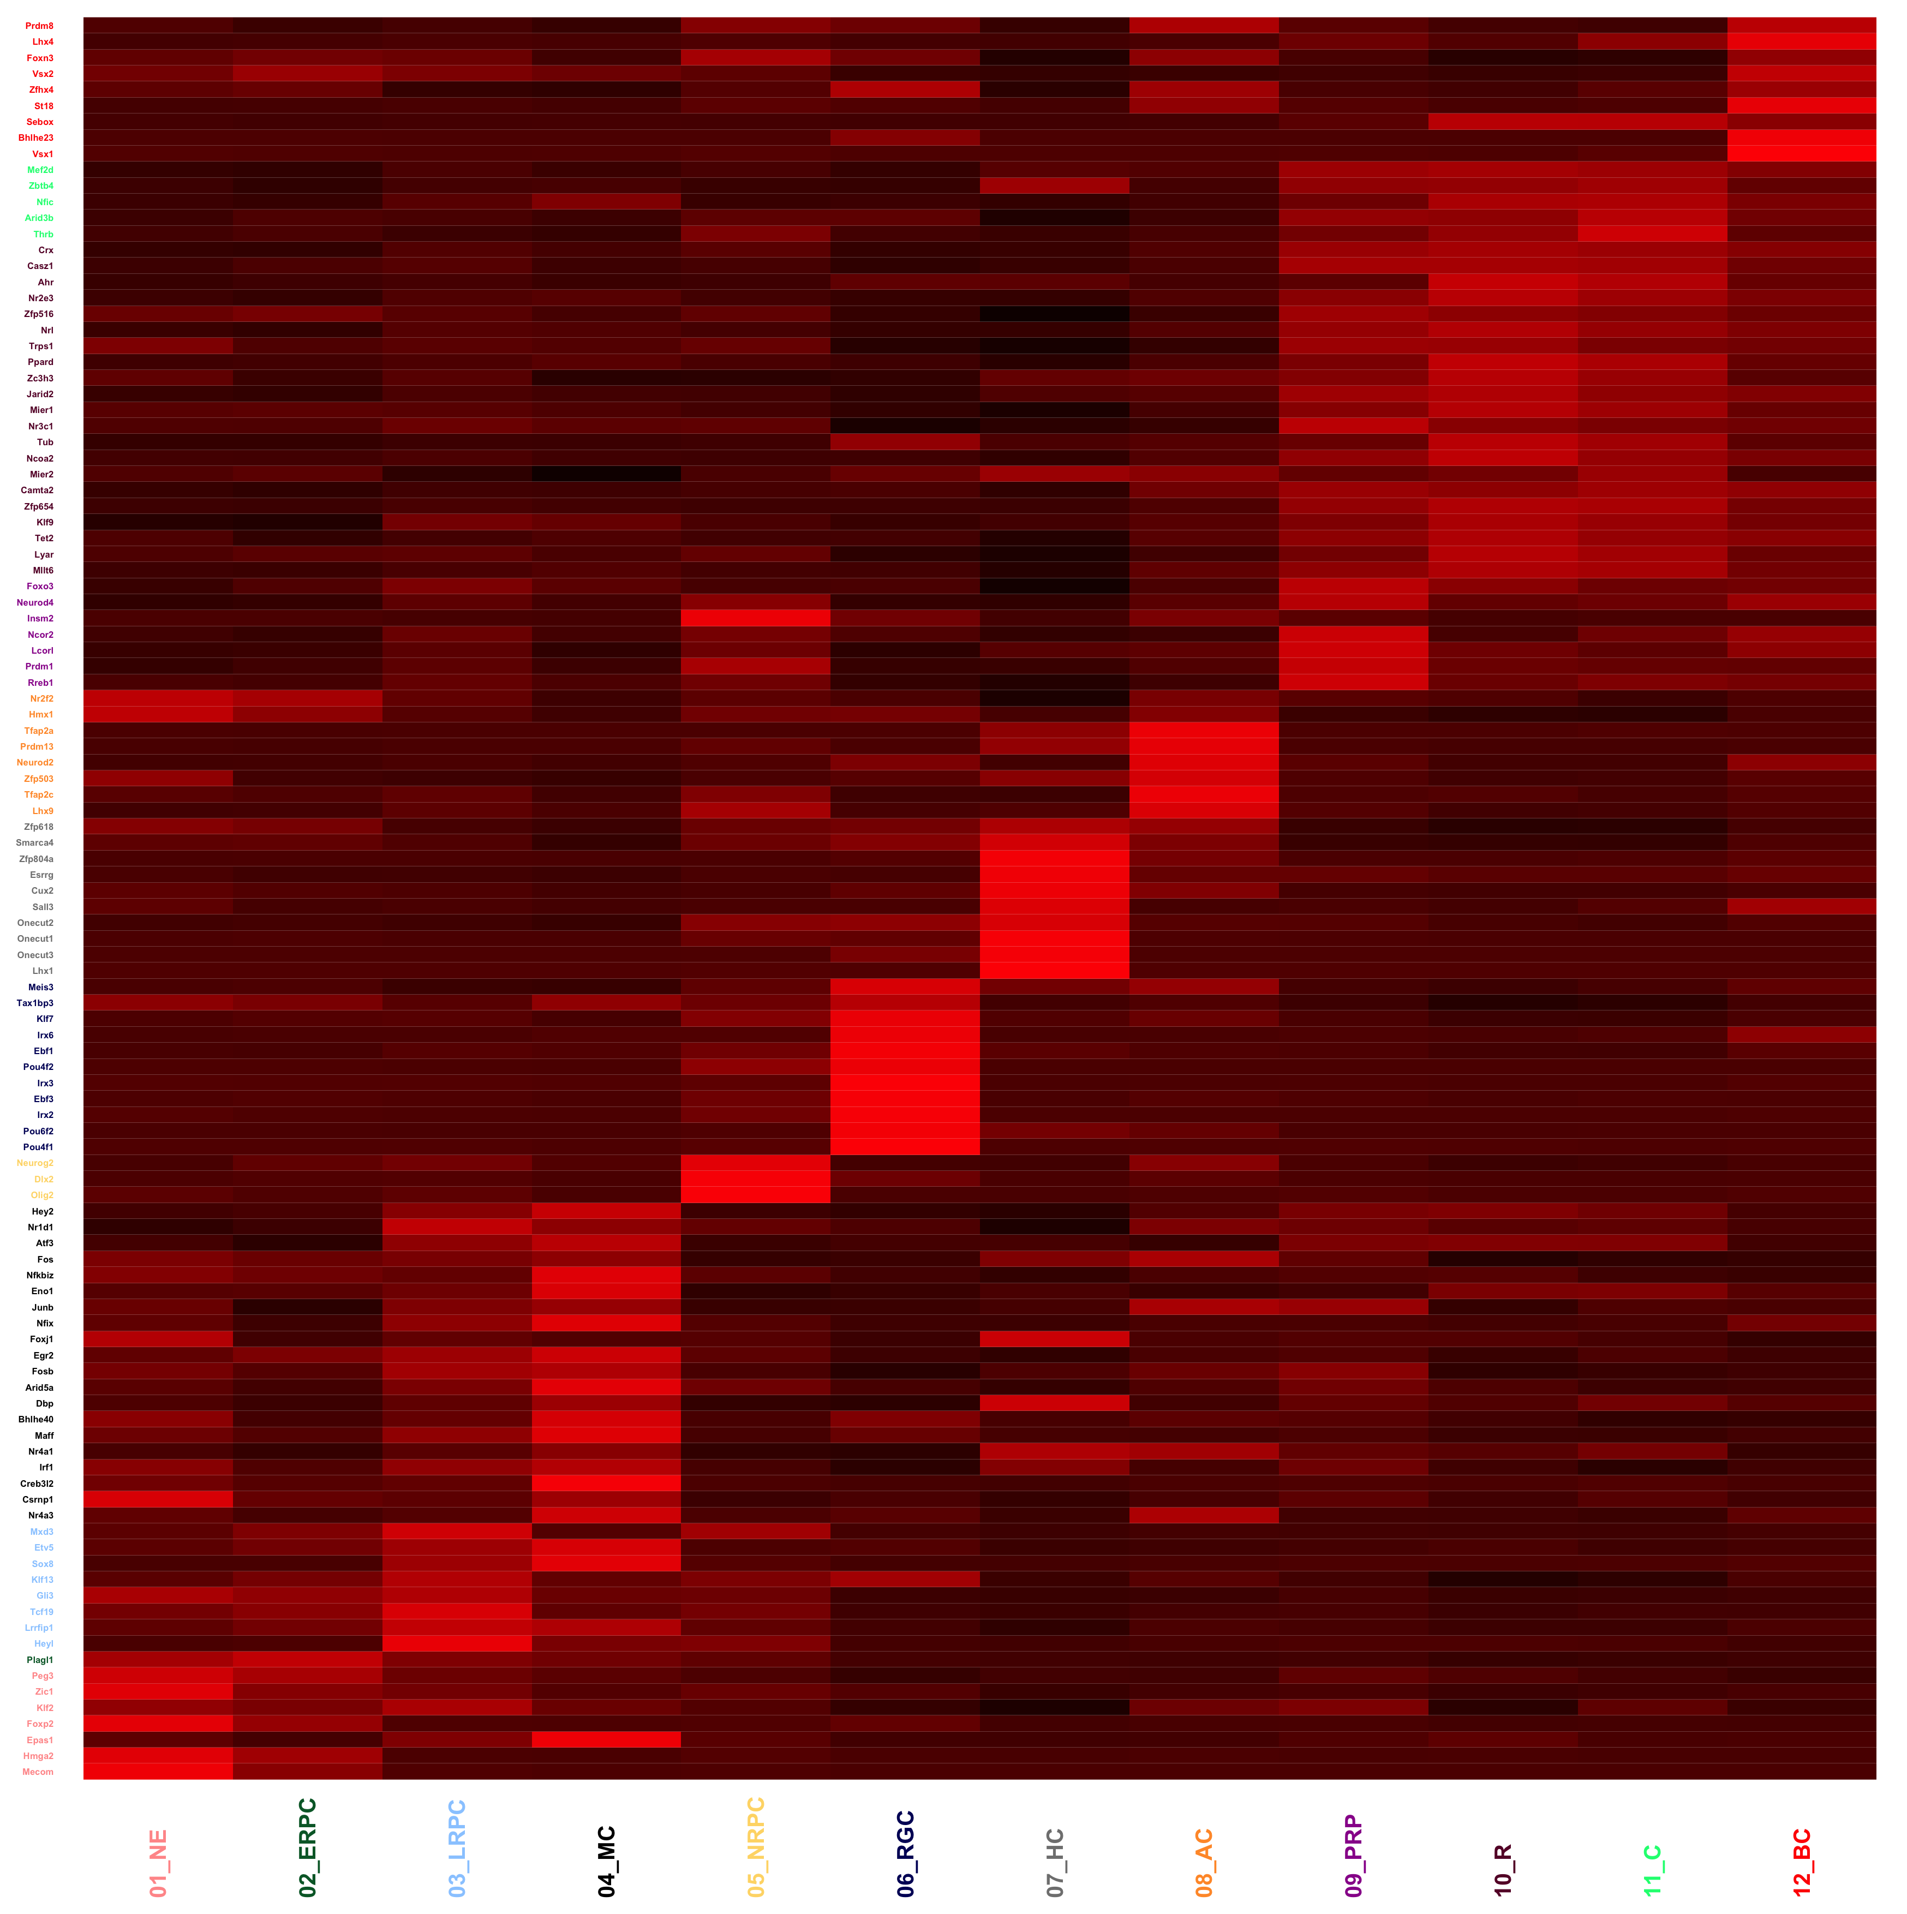
NE
RPE
ERPC
LRPC
NRPC
RGC
HC
AC
PRP
C
R
BC
MC
NE
RPE
ERPC
LRPC
NRPC
RGC
HC
AC
PRP
C
R
BC
MC
NE
RPE
ERPC
LRPC
NRPC
RGC
HC
AC
PRP
C
R
BC
MC
A
B
OVERLAP
Non dynamically regulated TF that
are DE between NaR and 3D-RA
NaR
3D-RA
Dynamically regulated (in NaR) TF sorted by cell type in which they are most strongly expressed
NE
ERPC
LRPC
MC
NRPC
RGC
HC
AC
PRP
R
C
BC
C
CLIQUE > OTHERS
NaR > 3D-RA
106
121
31
39
41
0
NE
RPE
ERPC
LRPC
NRPC
RGC
HC
AC
PRP
C
R
BC
MC
NE
RPE
ERPC
LRPC
NRPC
RGC
HC
AC
PRP
C
R
BC
MC
NE
RPE
ERPC
LRPC
NRPC
RGC
HC
AC
PRP
C
R
BC
MC
Nr DE TF
Total: 357
19
3D-RA > NaR
NaR > 3D-RA
OVERLAP
CLIQUE > OTHERS
3D-RA > NaR

Slide 6
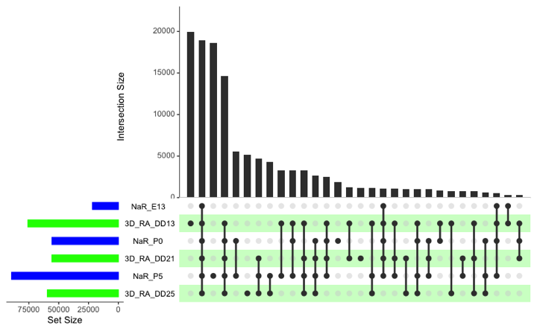
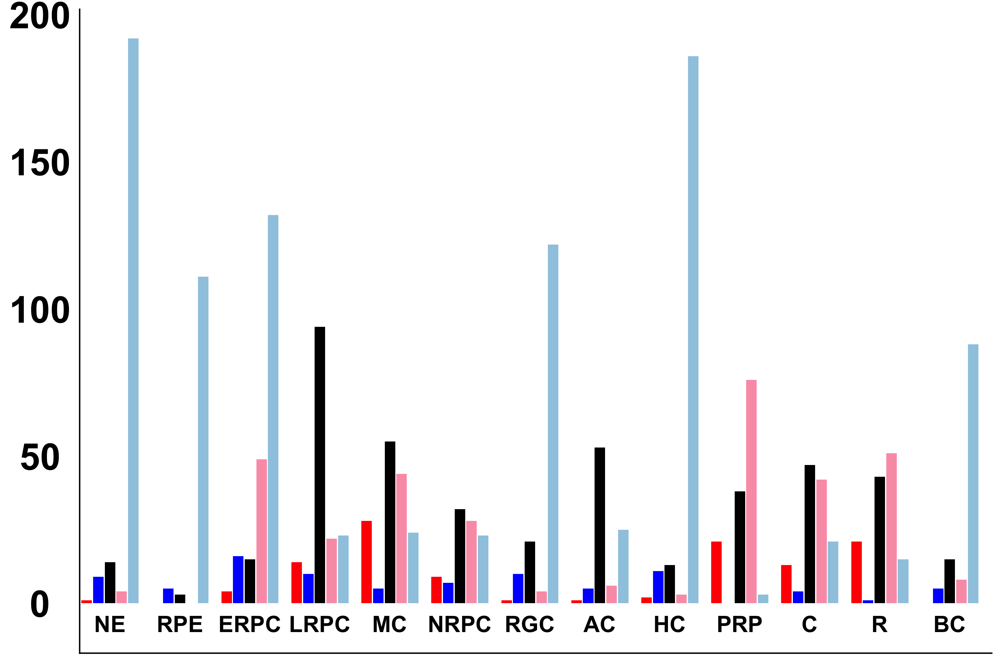
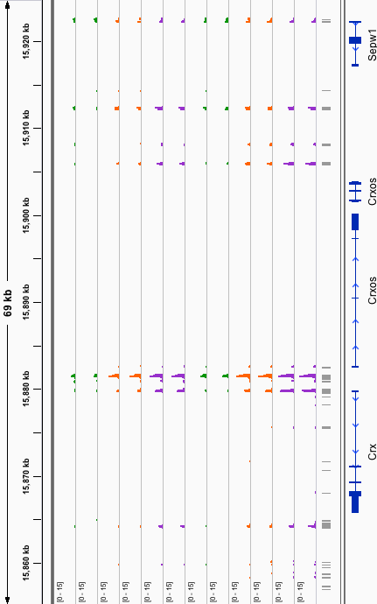
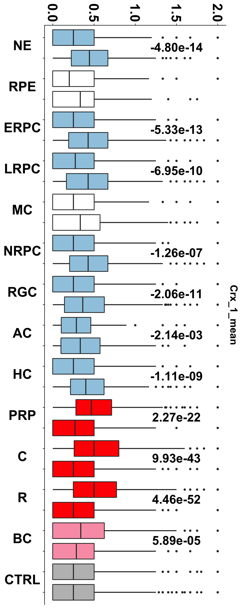
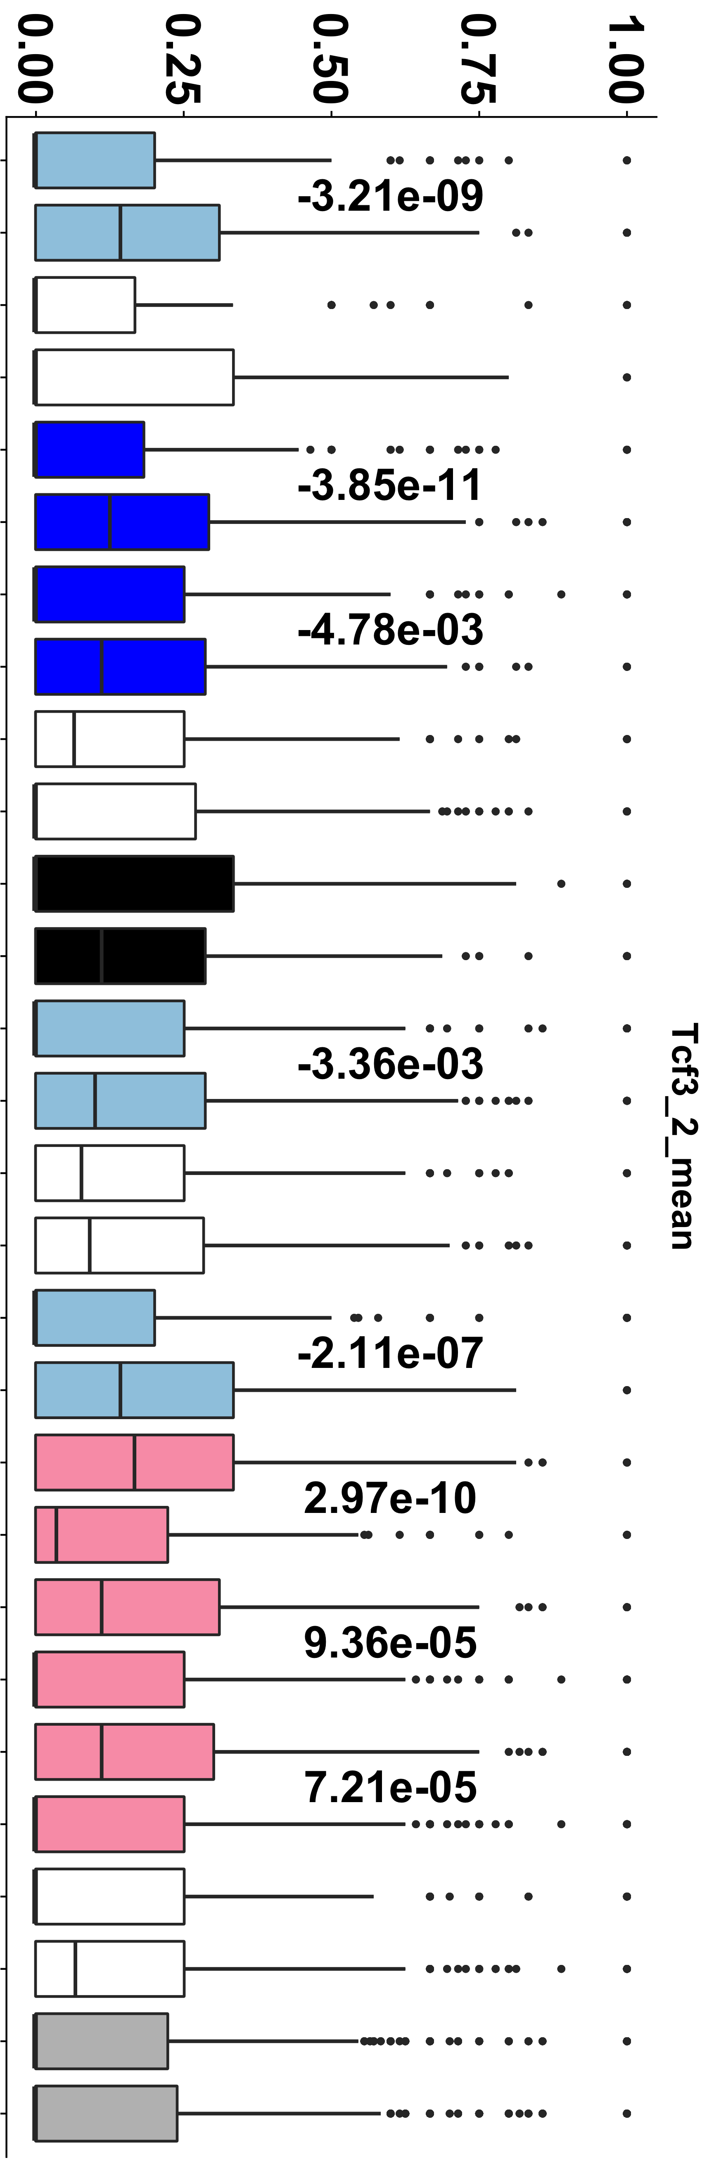
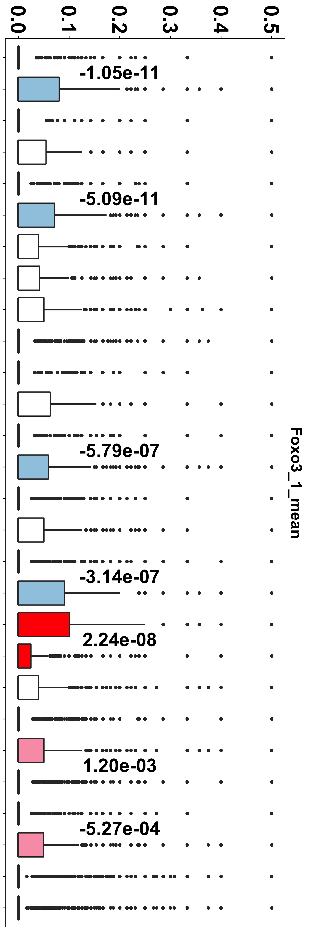
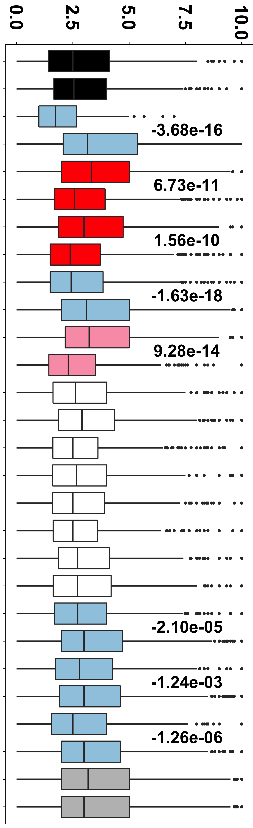
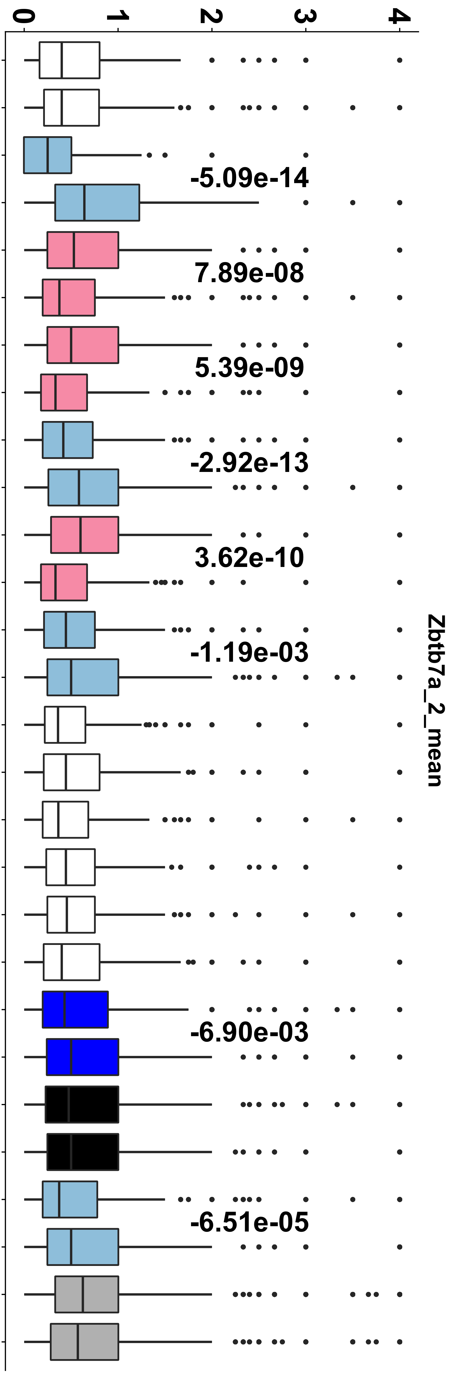
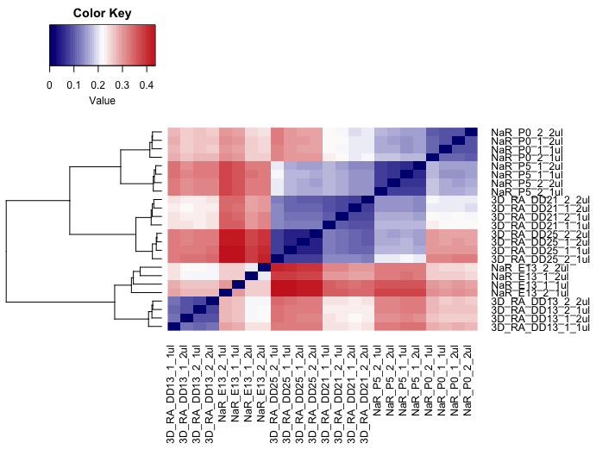
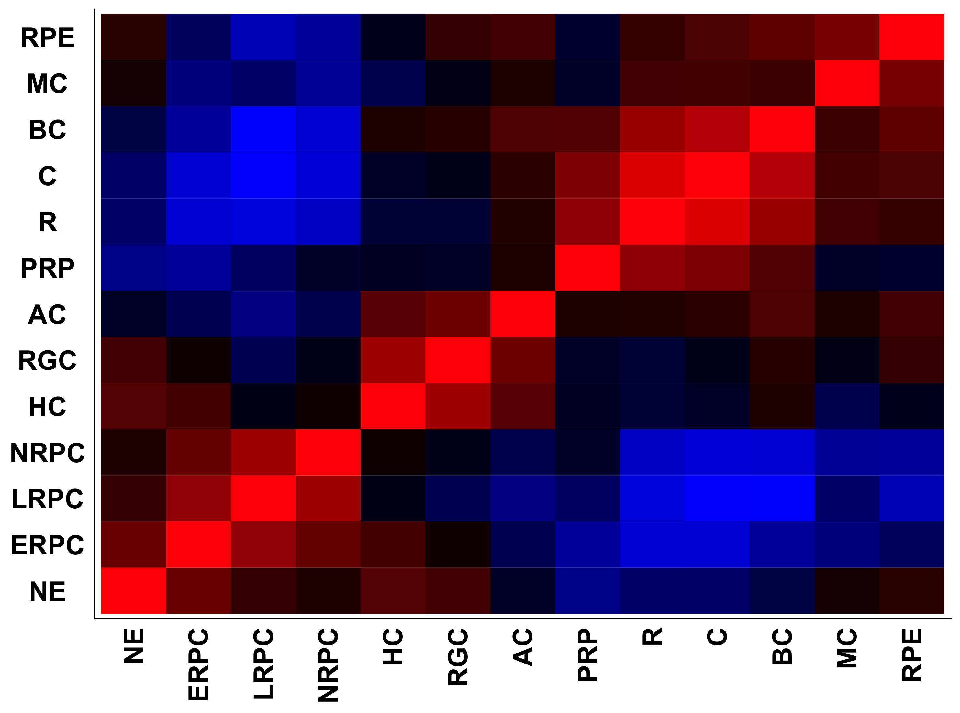
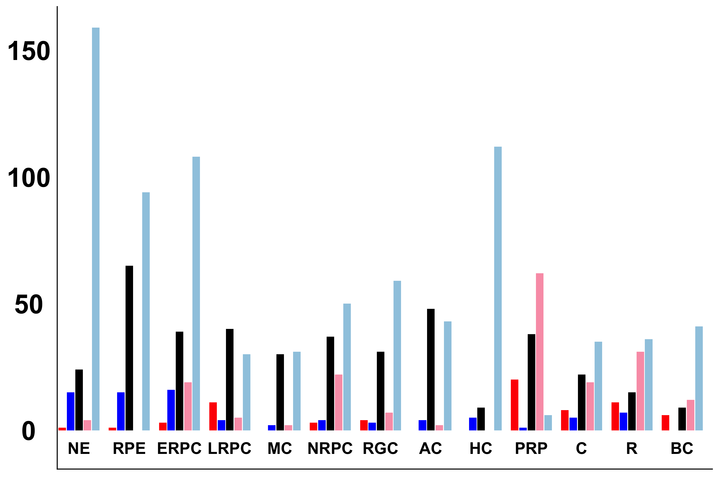
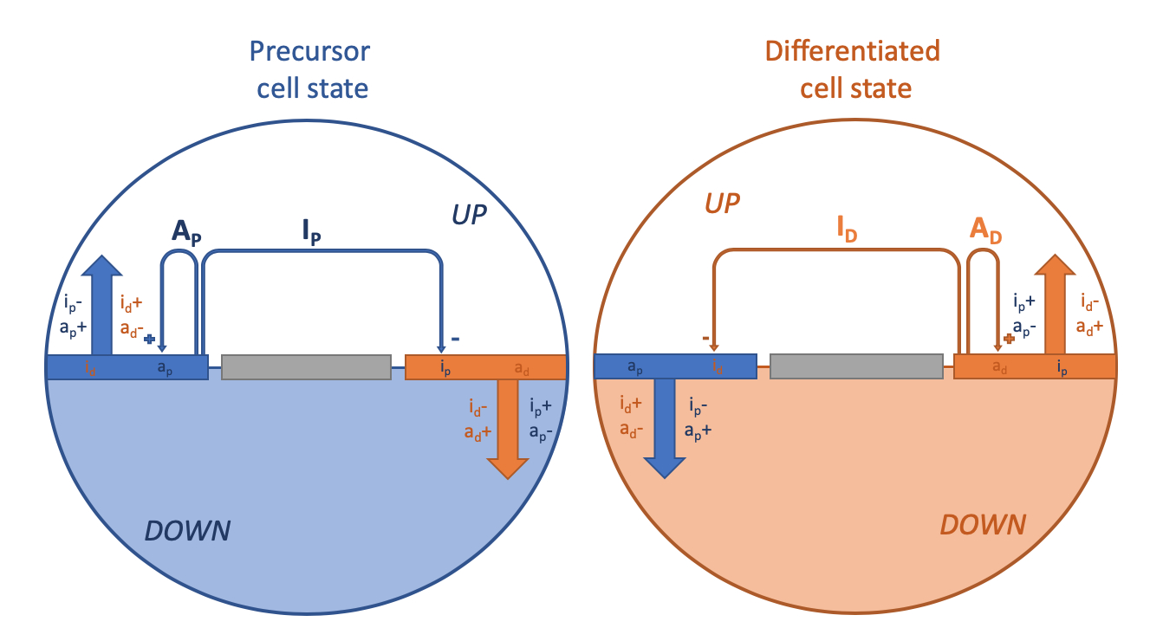
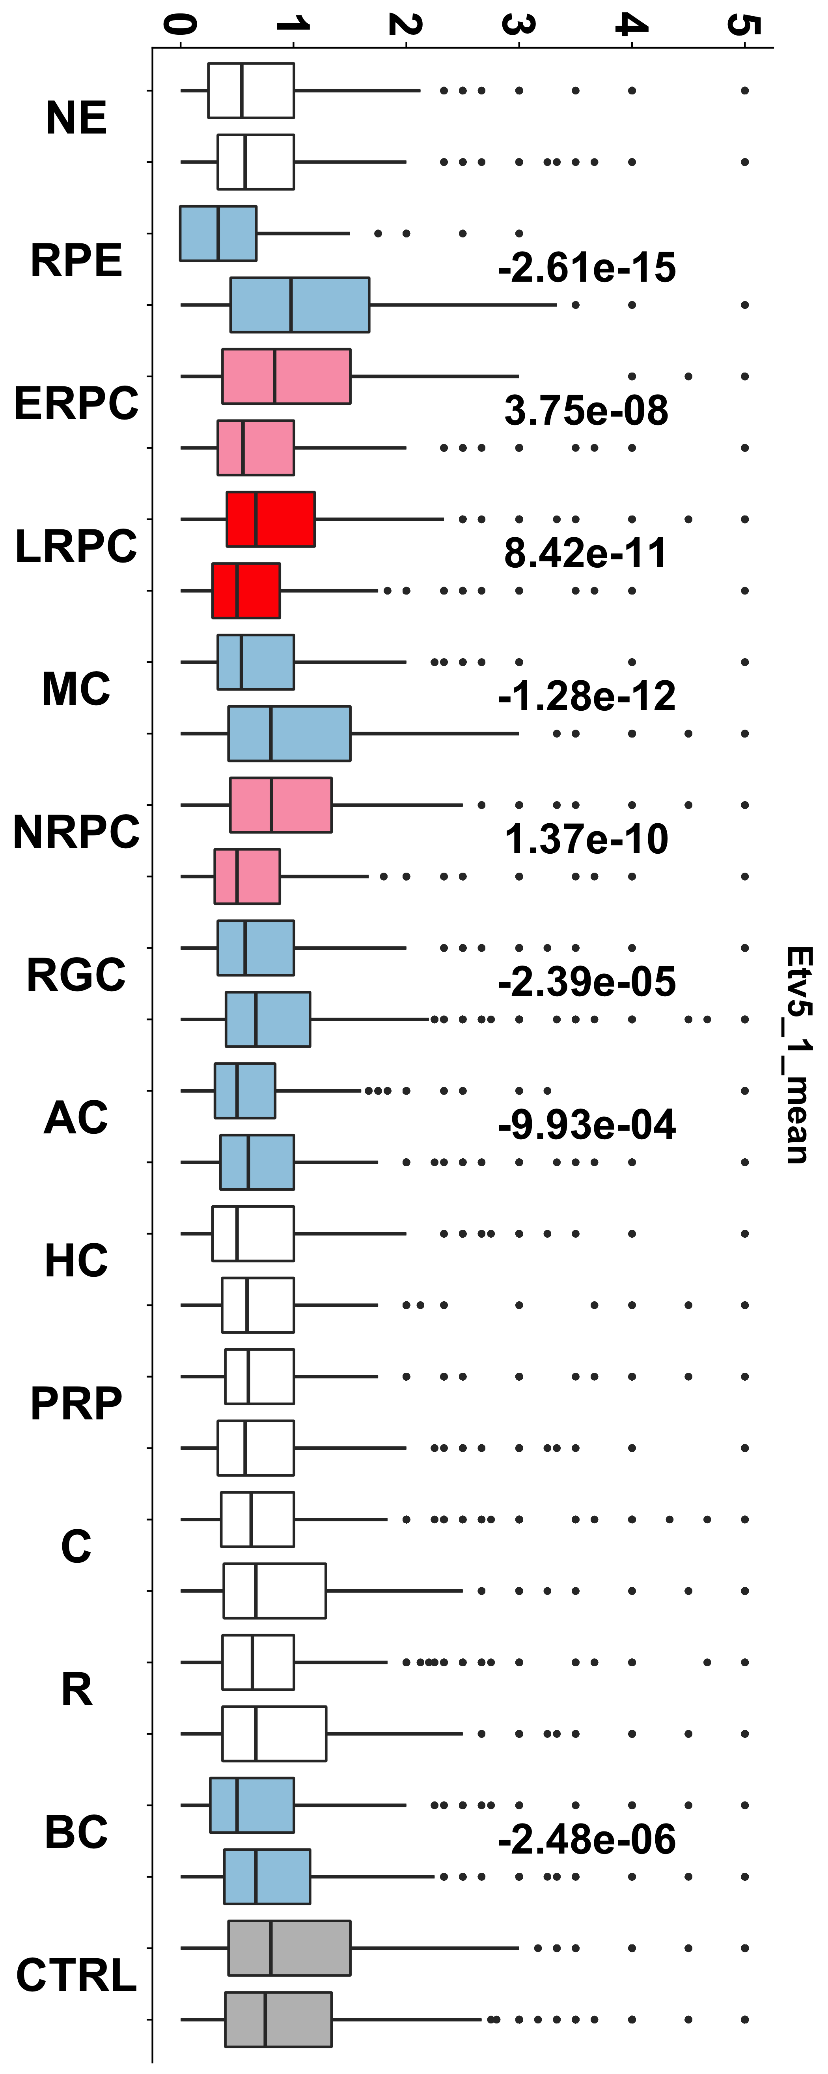
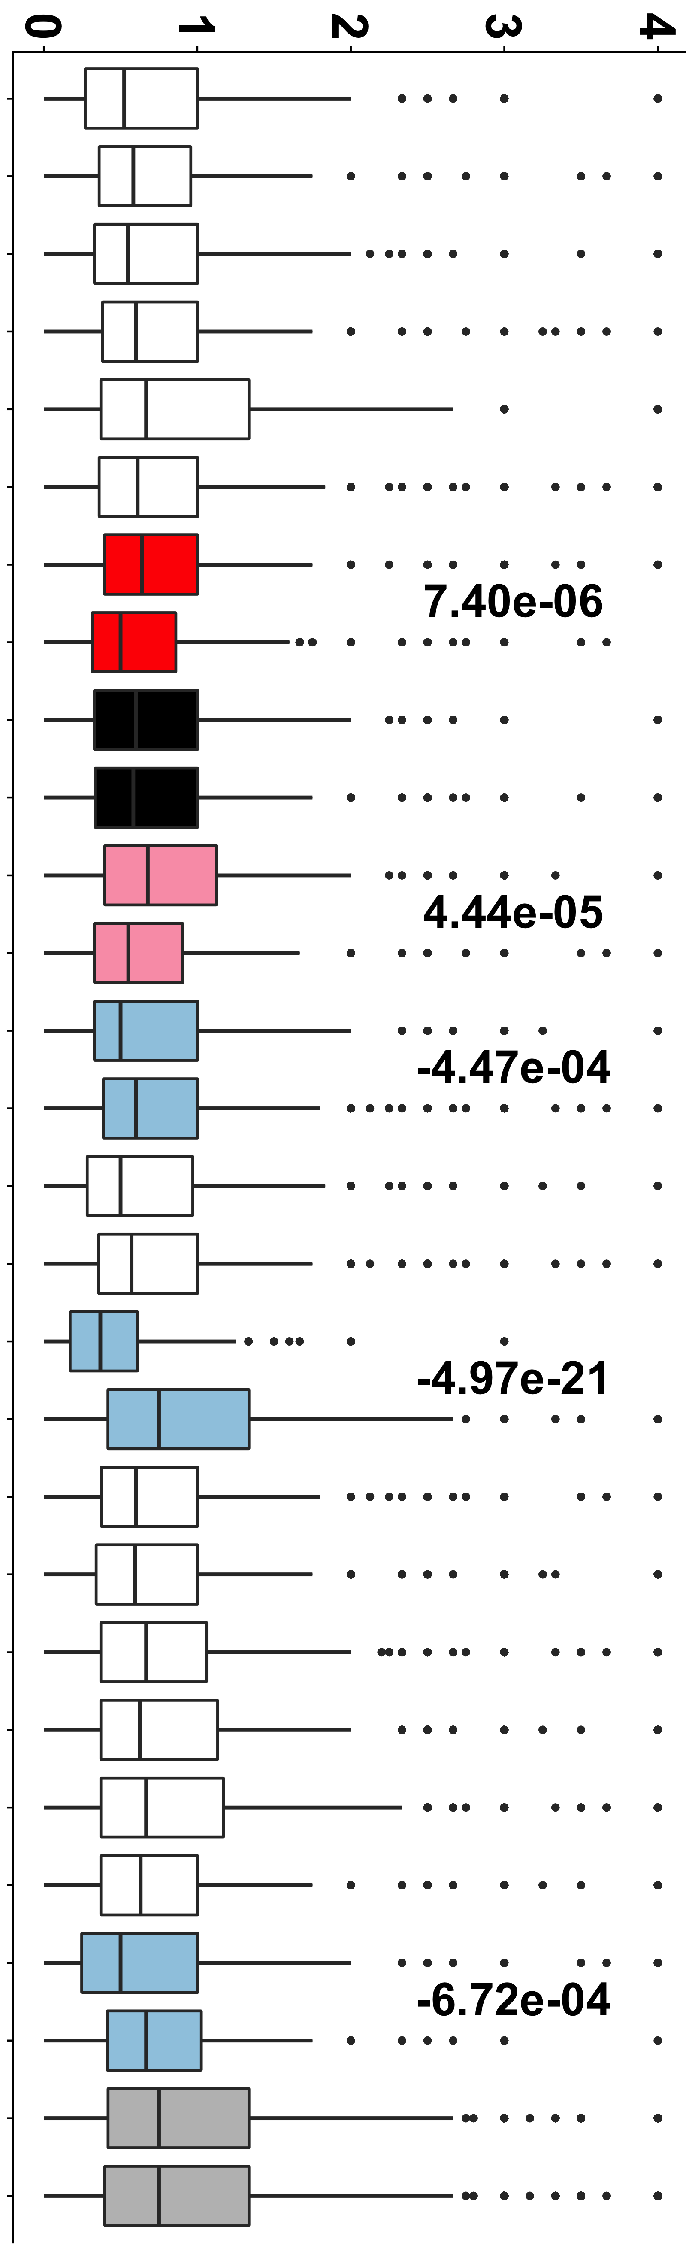
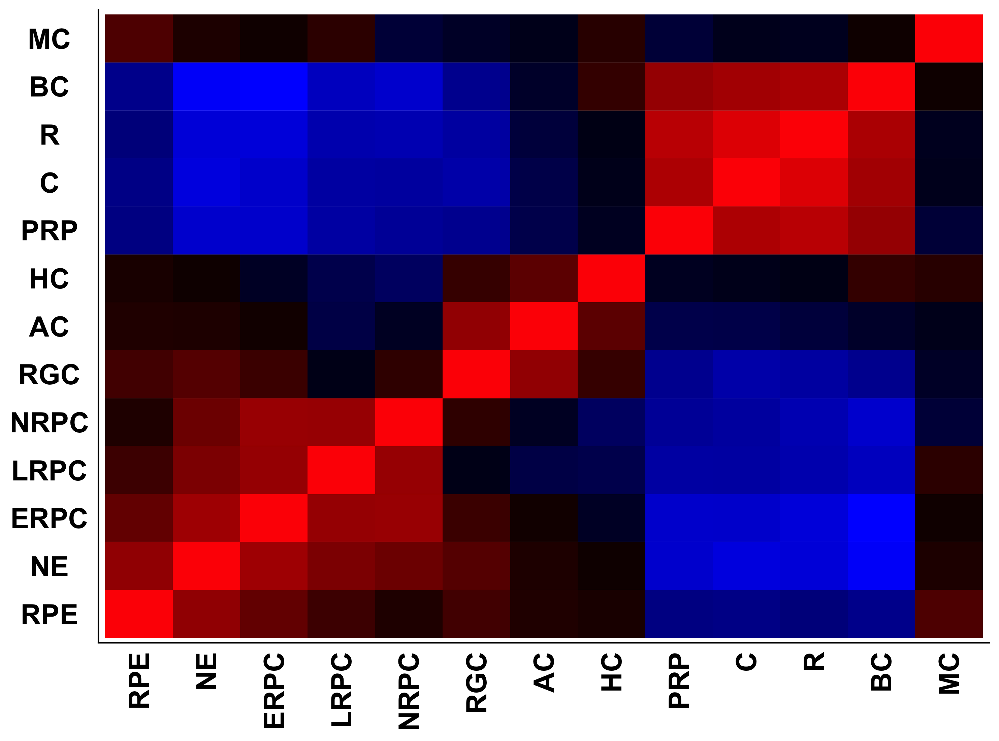
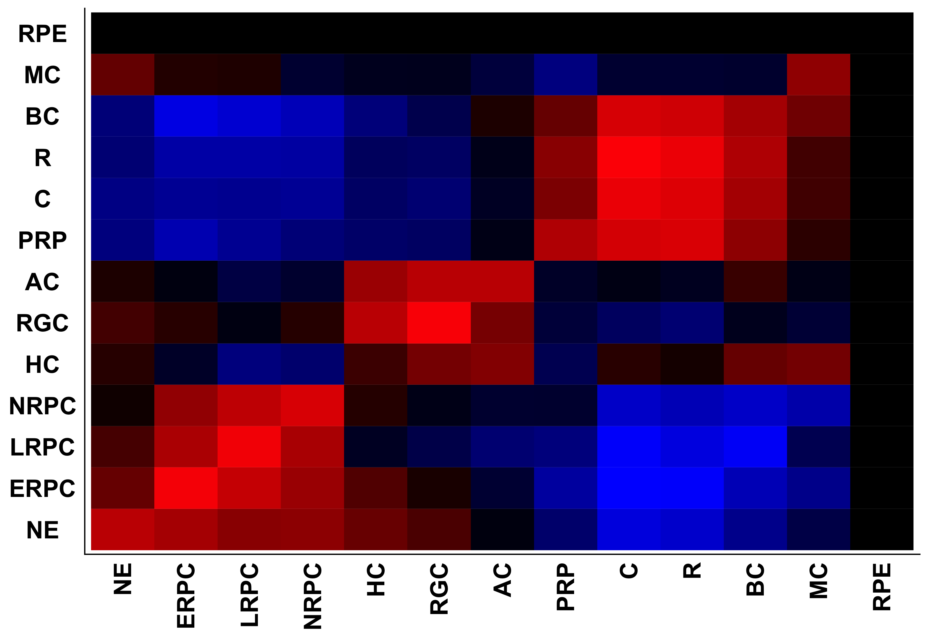
A
ATAC
peaks
B
E
G
Average number of binding motifs per ATAC-Seq peak
UP
DN
Nr of events
C
F
P0
P5
DD21
NaR
DD25
DD13
E13
P0
P5
DD13
DD21
DD25
E13
NaR
3D-RA
H
Crx
Foxo3
Zbtb7a
Tcf3
Hes1
D
C1
C2
NaR
C3
K
NaR
3D-RA
UP
DN
Nr of events
I
J
3d-RA
NaR
C2
C3
3d-RA
Etv5
C1
3d-RA

Slide 7
Precursor
cell state
Differentiated
cell state
UP
UP
A_{P}
I_{P}
I_{D}
A_{D}
i_{p}-
a_{p}+
i_{d}+
a_{d}-
i_{p}+
a_{p}-
i_{d}-
a_{d}+
i_{d}
a_{p}
i_{p}
a_{d}
a_{p}
i_{d}
a_{d}
i_{p}
i_{d}-
a_{d}+
i_{p}+
a_{p}-
i_{d}+
a_{d}-
i_{p}-
a_{p}+
DOWN
DOWN

